Slide 1
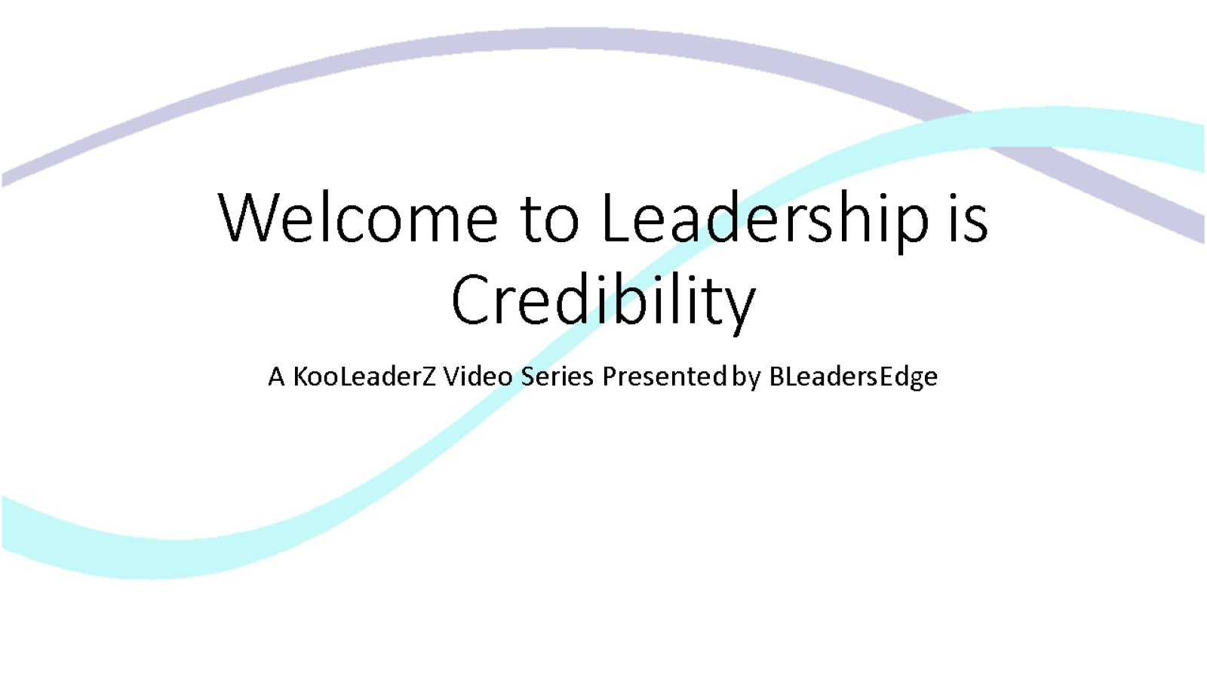

Welcome to Leadership is Credibility

Slide 2
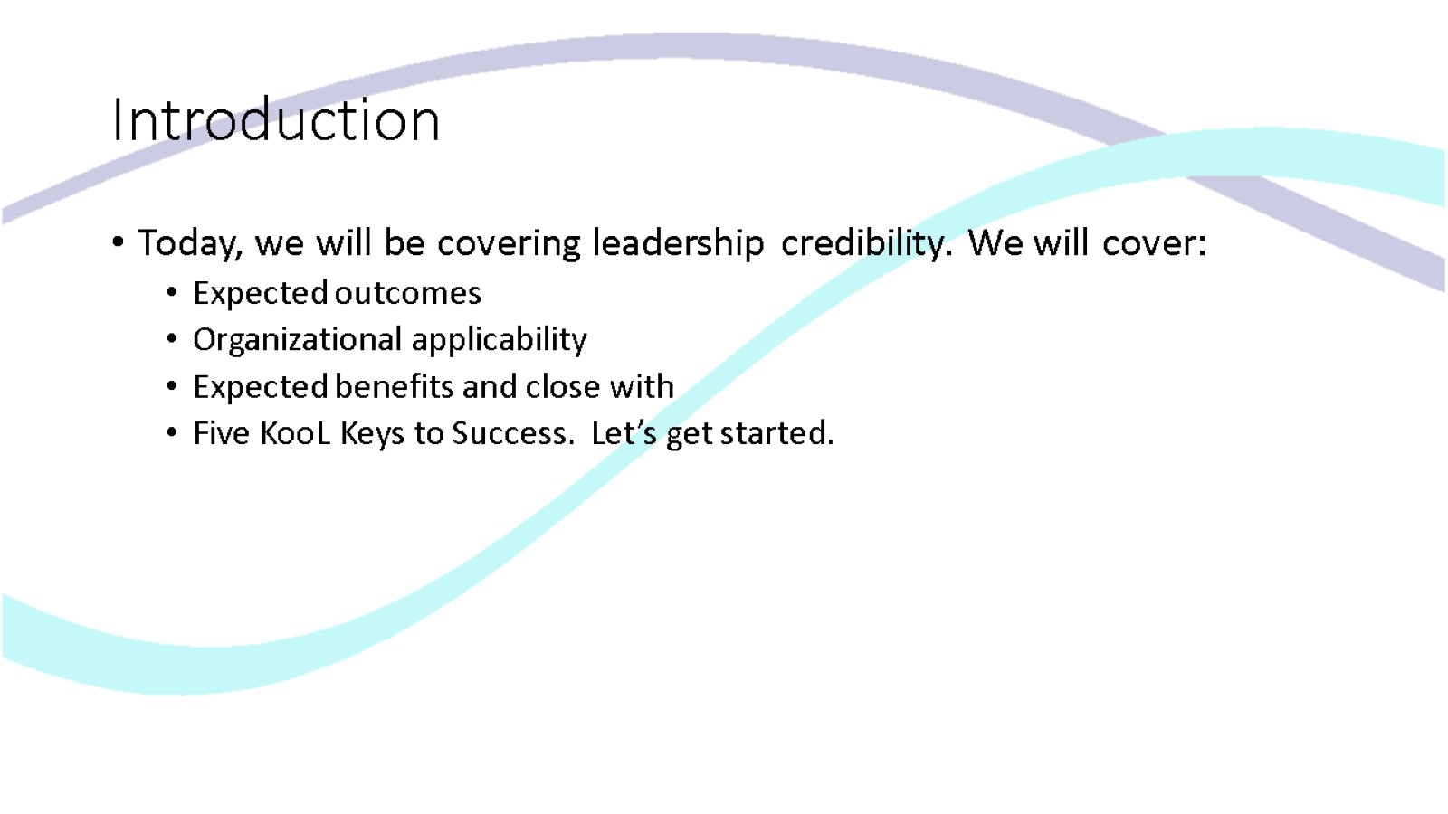
Introduction

Slide 3
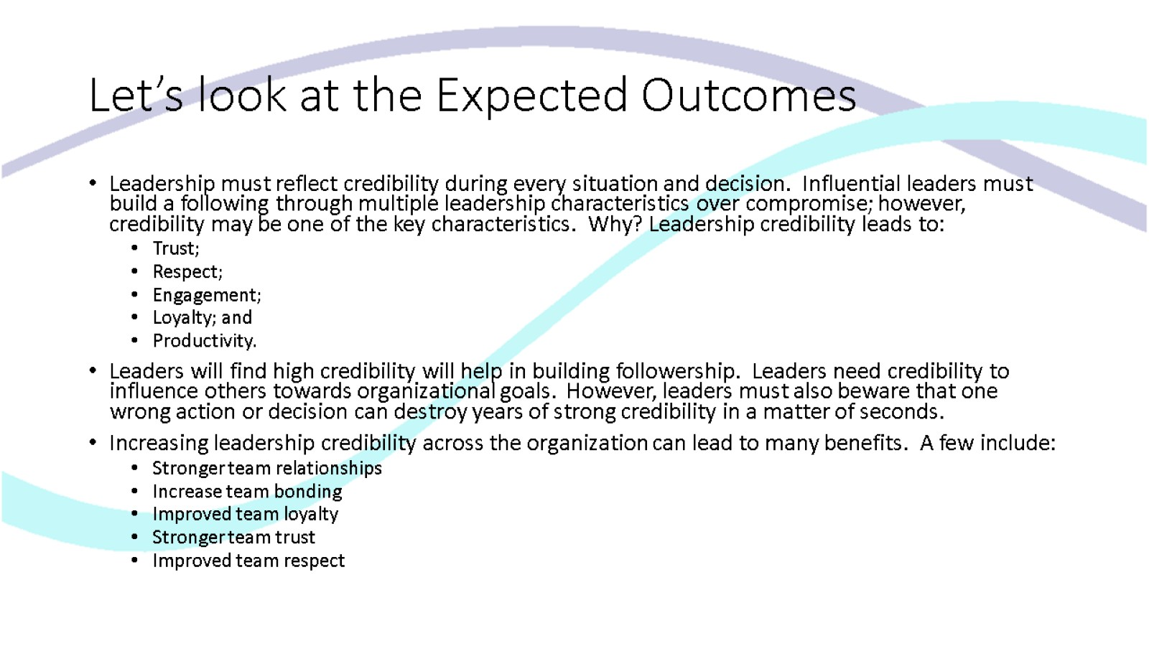
Let’s look at the Expected Outcomes

Slide 4
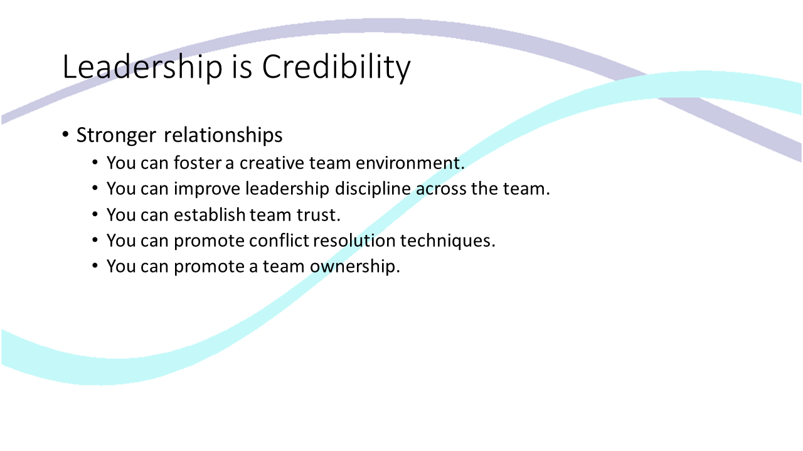
Leadership is Credibility

Slide 5
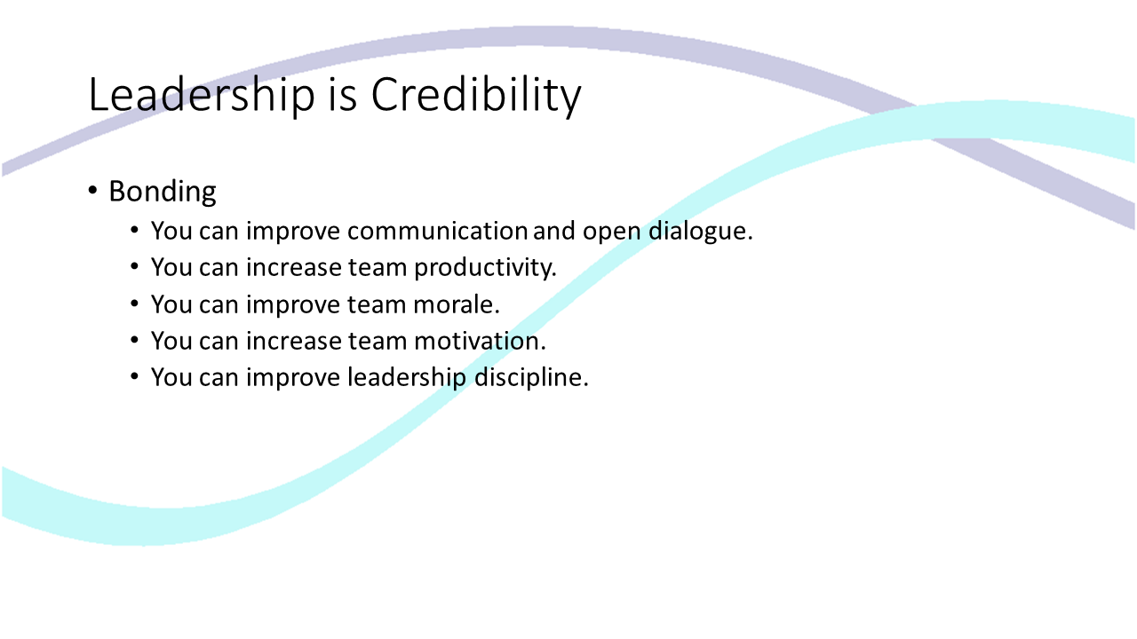
Leadership is Credibility

Slide 6
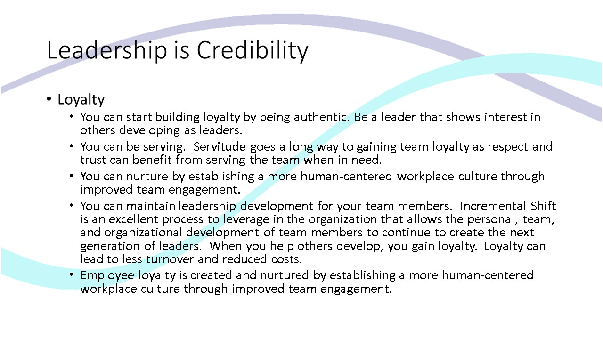
Leadership is Credibility

Slide 7
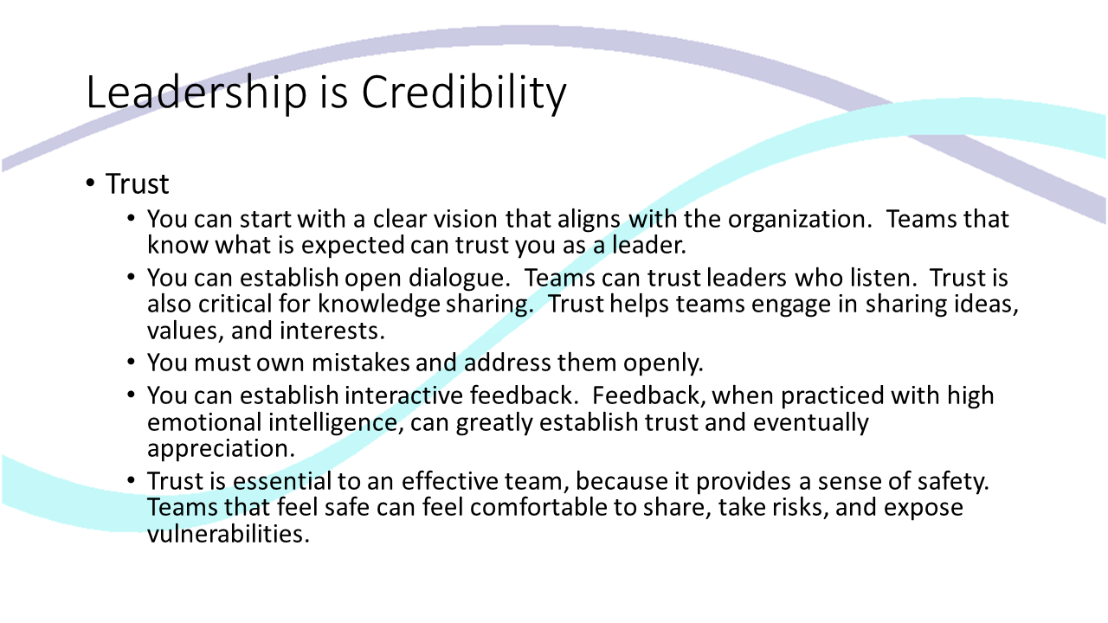
Leadership is Credibility

Slide 8
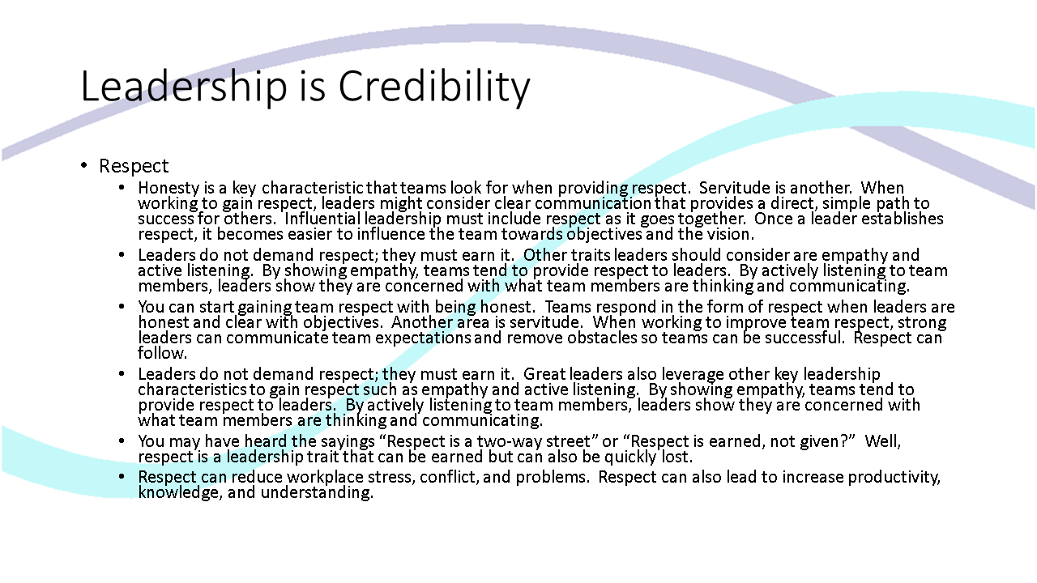
Leadership is Credibility

Slide 9
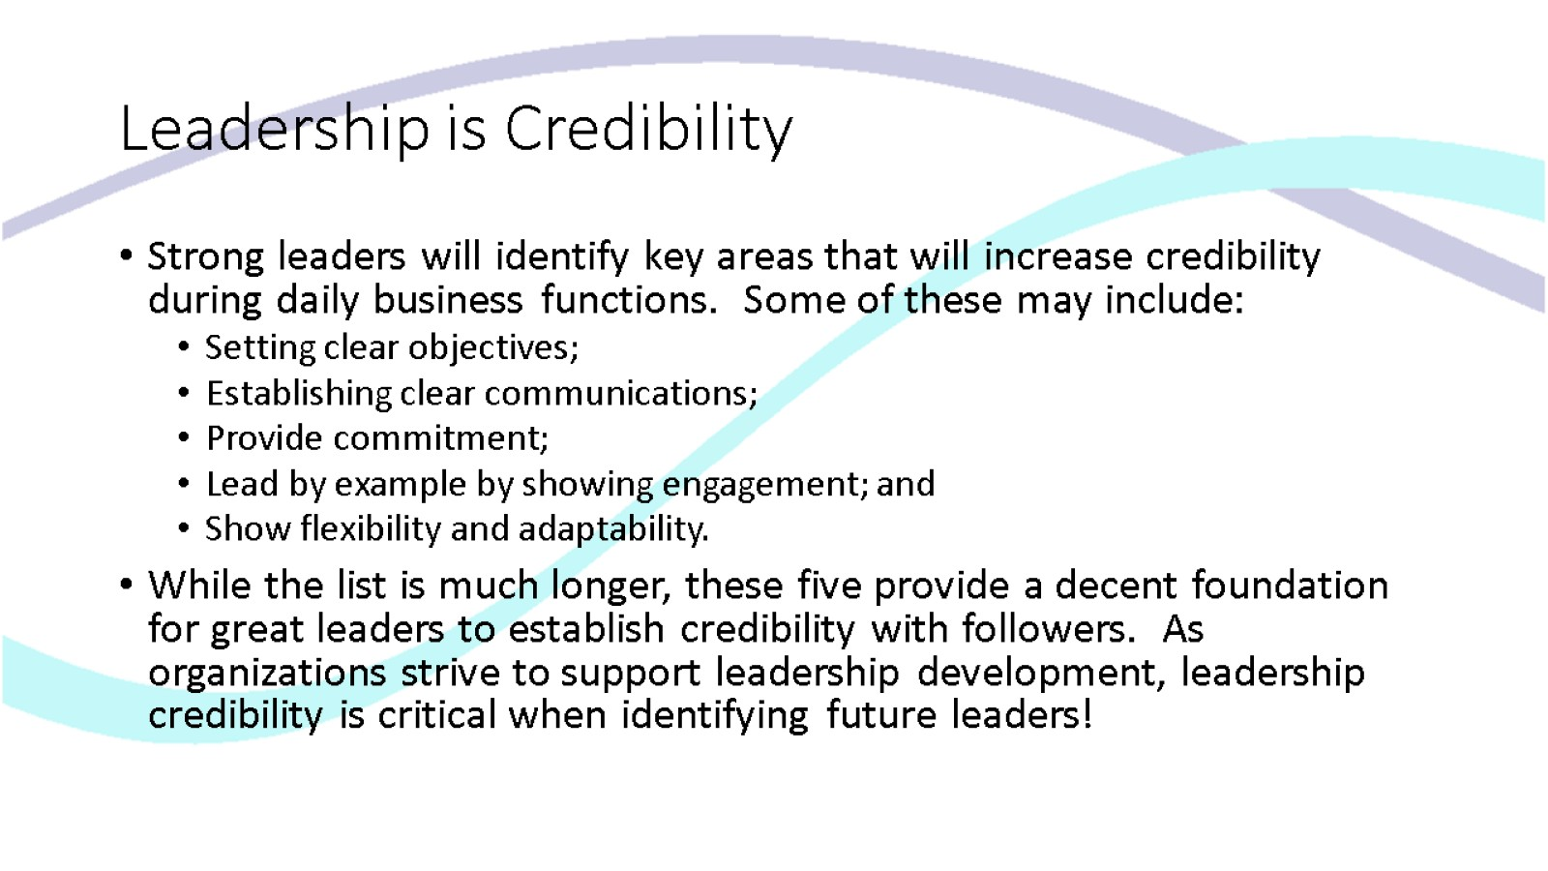
Leadership is Credibility

Slide 10
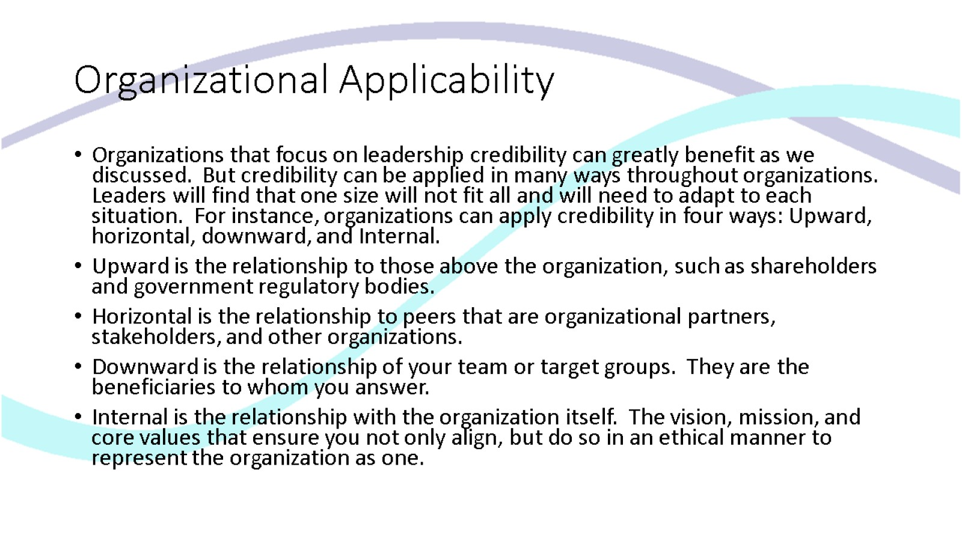
Organizational Applicability

Slide 11
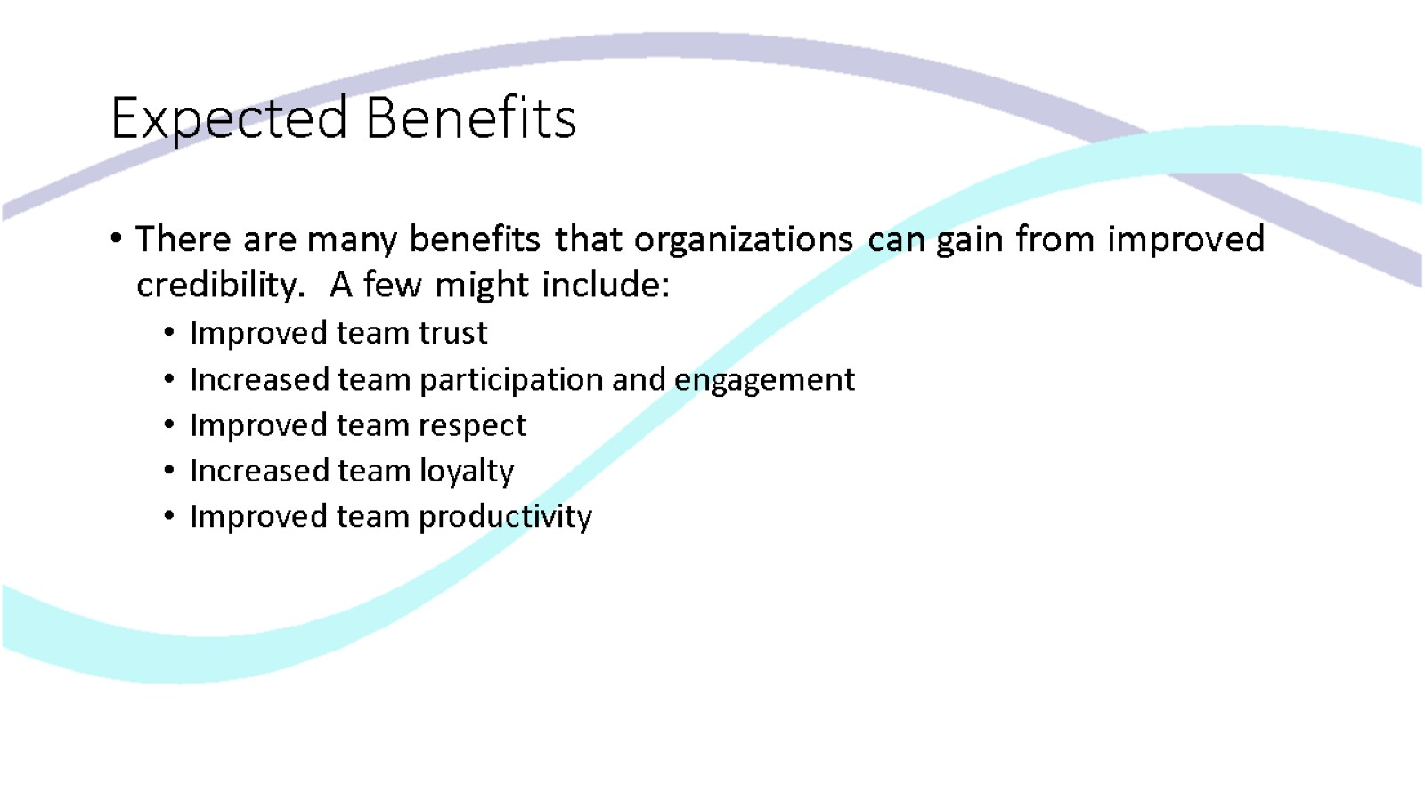
Expected Benefits

Slide 12
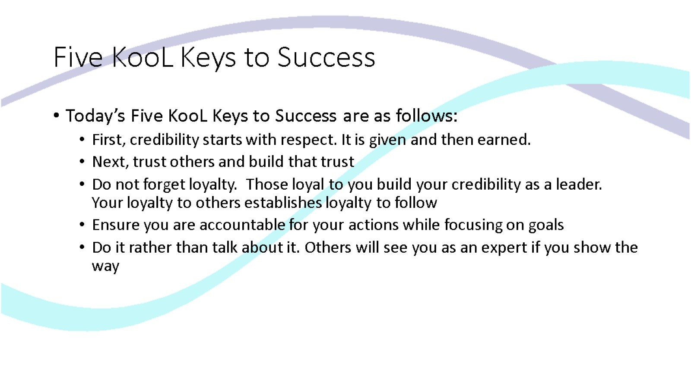
Five KooL Keys to Success

Slide 13
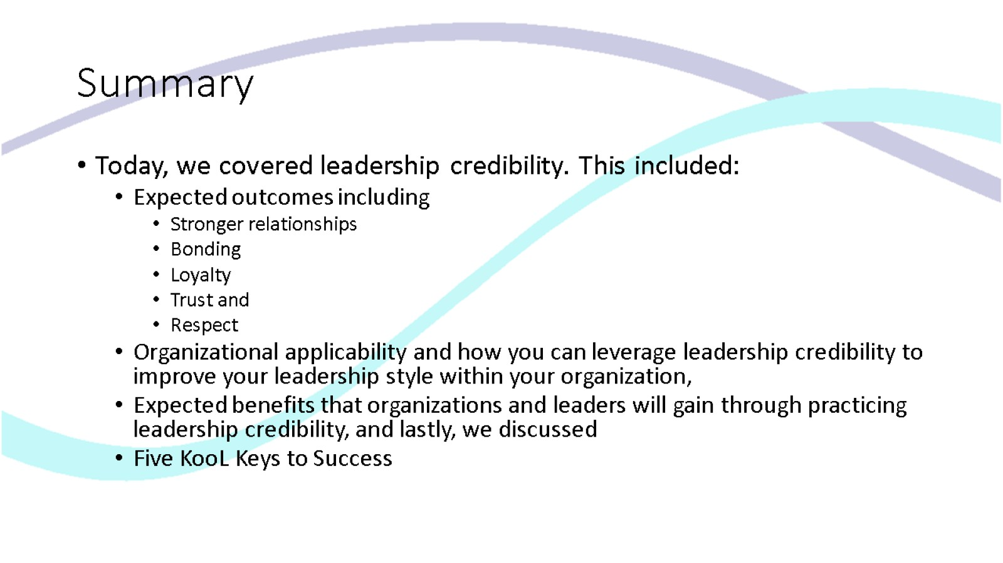
Summary

Slide 14

Thank you for viewing Leadership is Credibility

