Slide 1
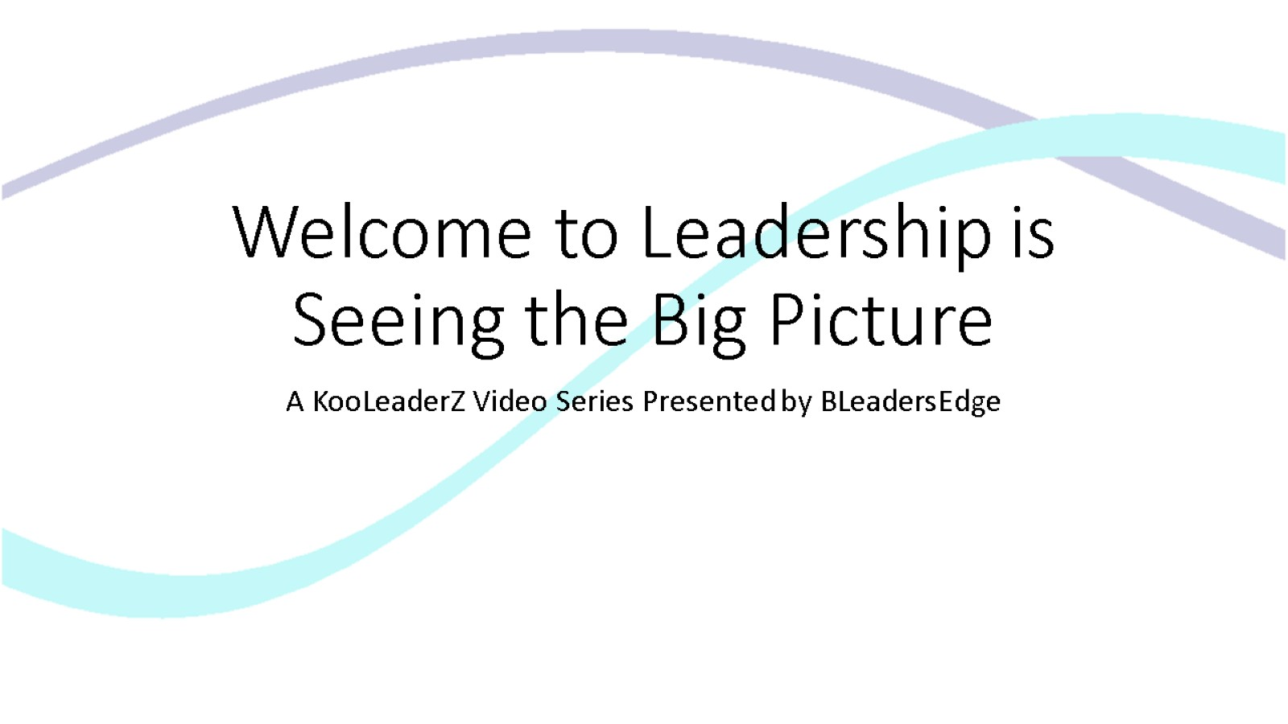

Welcome to Leadership is Seeing the Big Picture

Slide 2
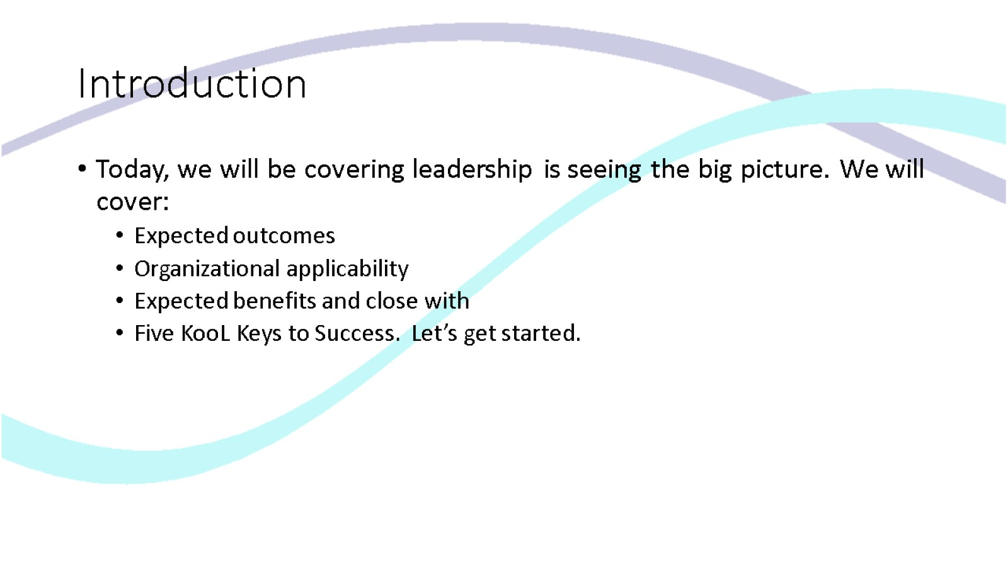
Introduction

Slide 3
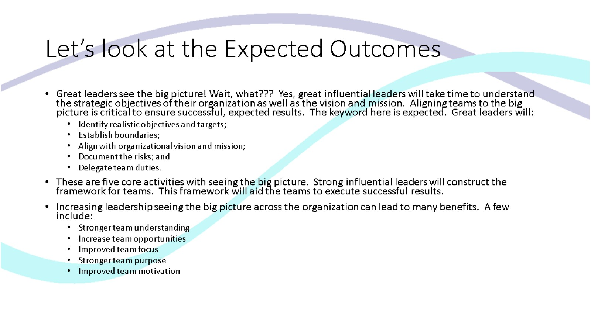
Let’s look at the Expected Outcomes

Slide 4
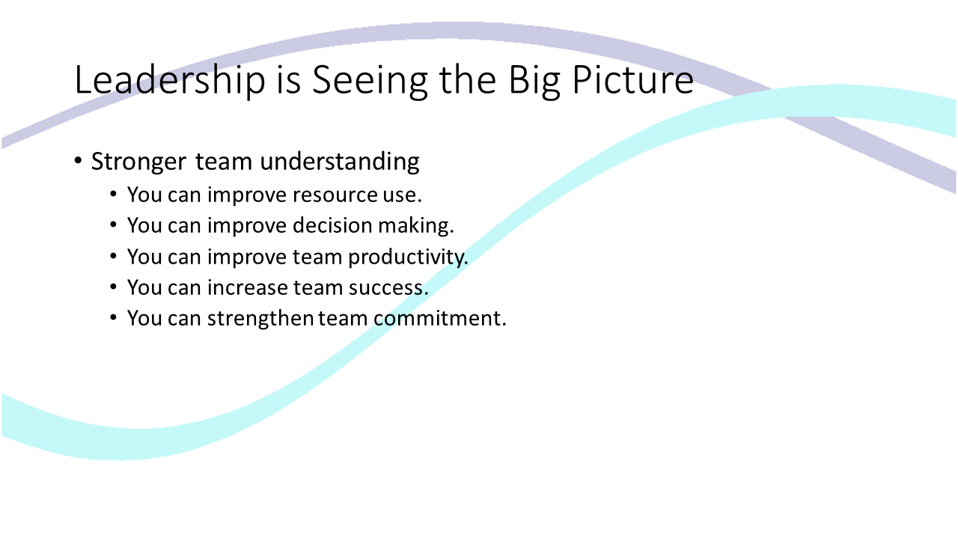
Leadership is Seeing the Big Picture

Slide 5
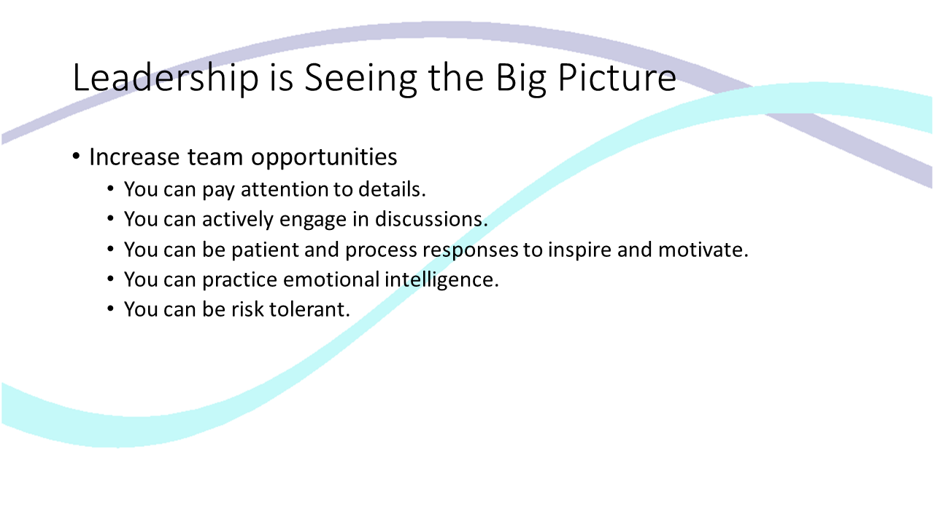
Leadership is Seeing the Big Picture

Slide 6
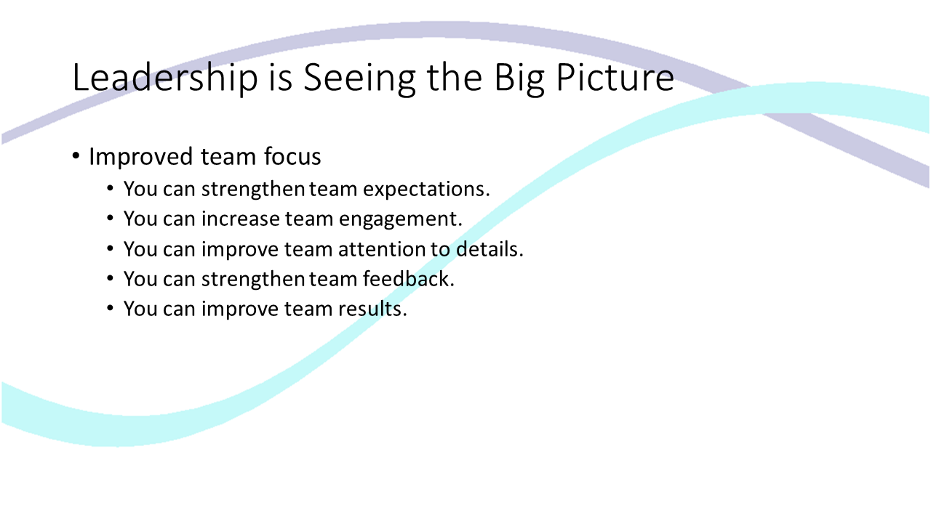
Leadership is Seeing the Big Picture

Slide 7
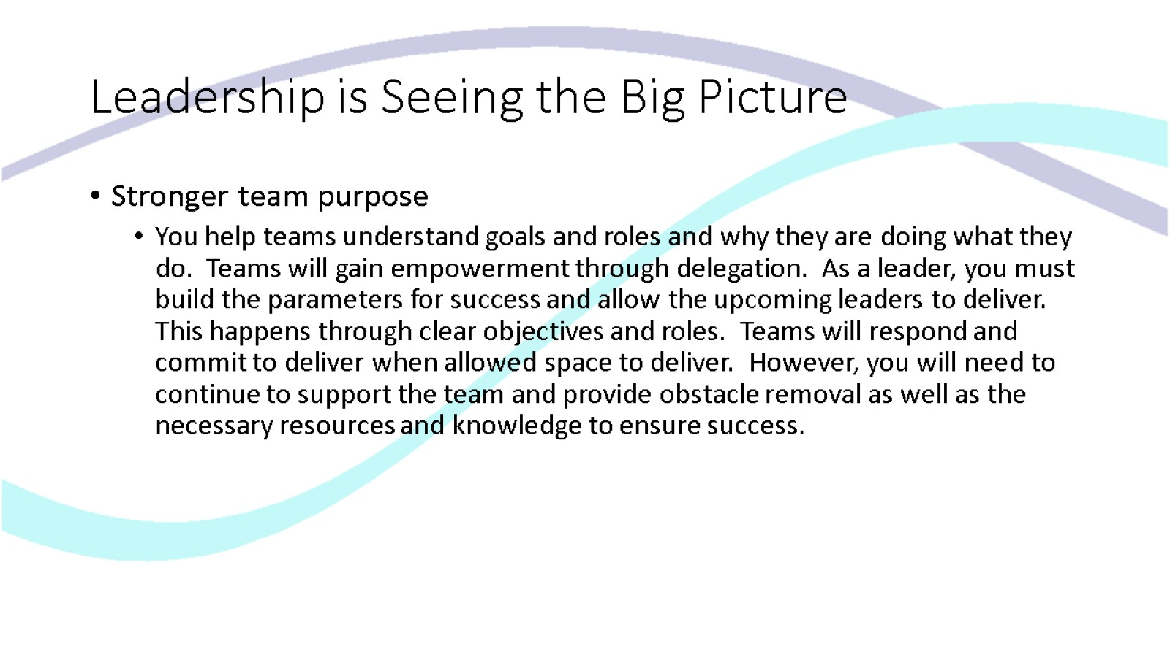
Leadership is Seeing the Big Picture

Slide 8
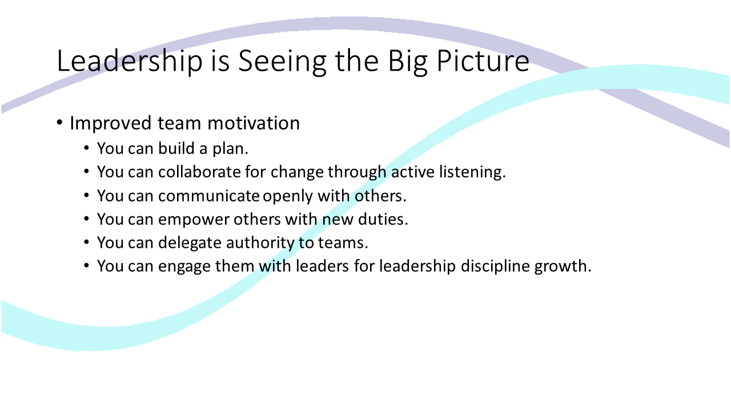
Leadership is Seeing the Big Picture

Slide 9
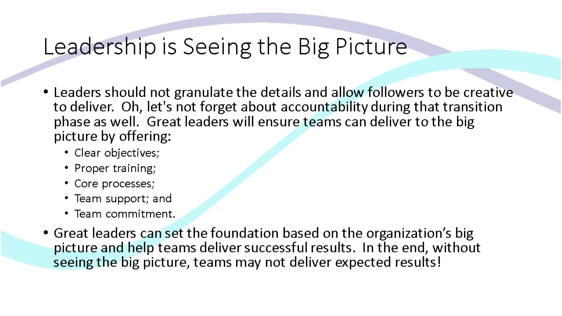
Leadership is Seeing the Big Picture

Slide 10
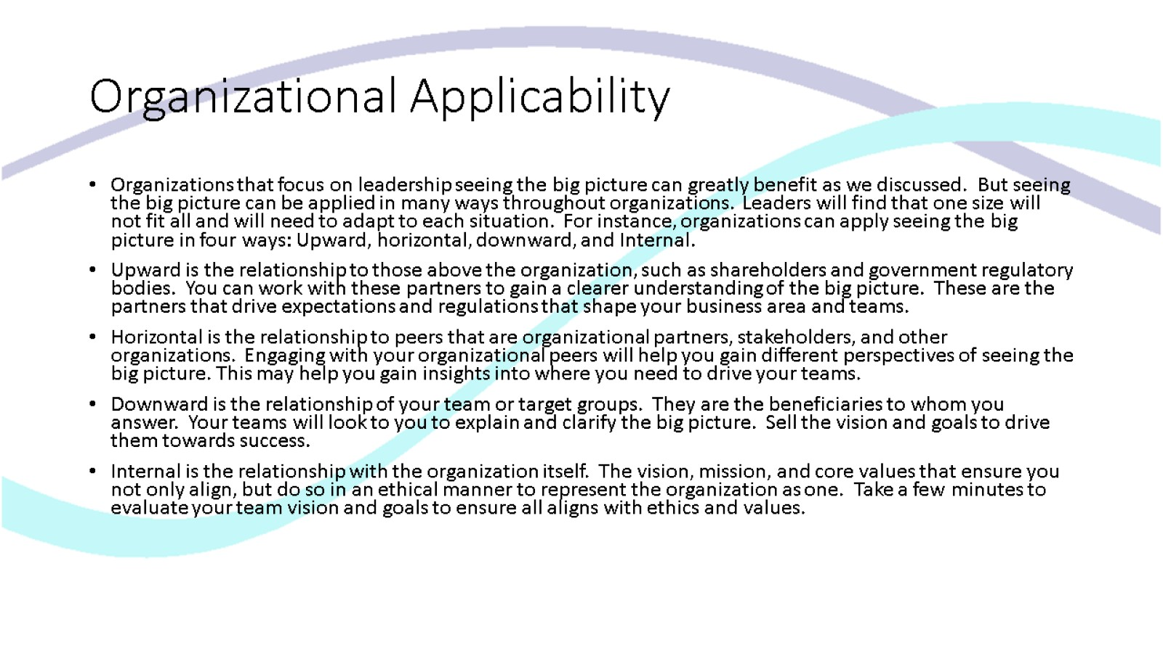
Organizational Applicability

Slide 11
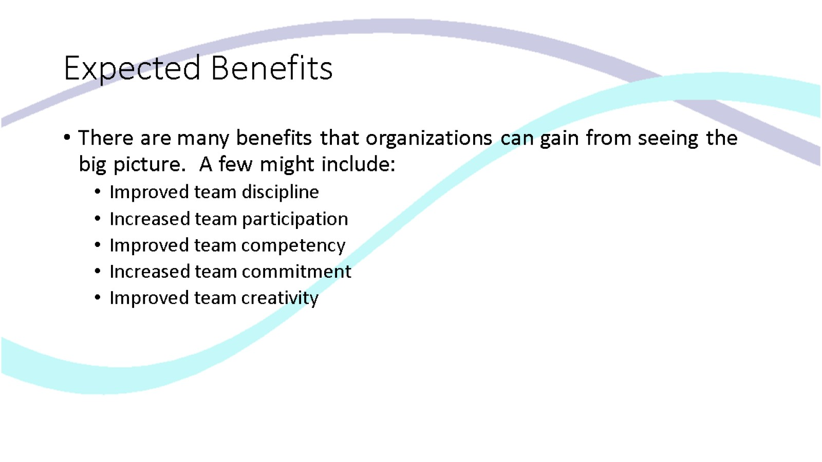
Expected Benefits

Slide 12
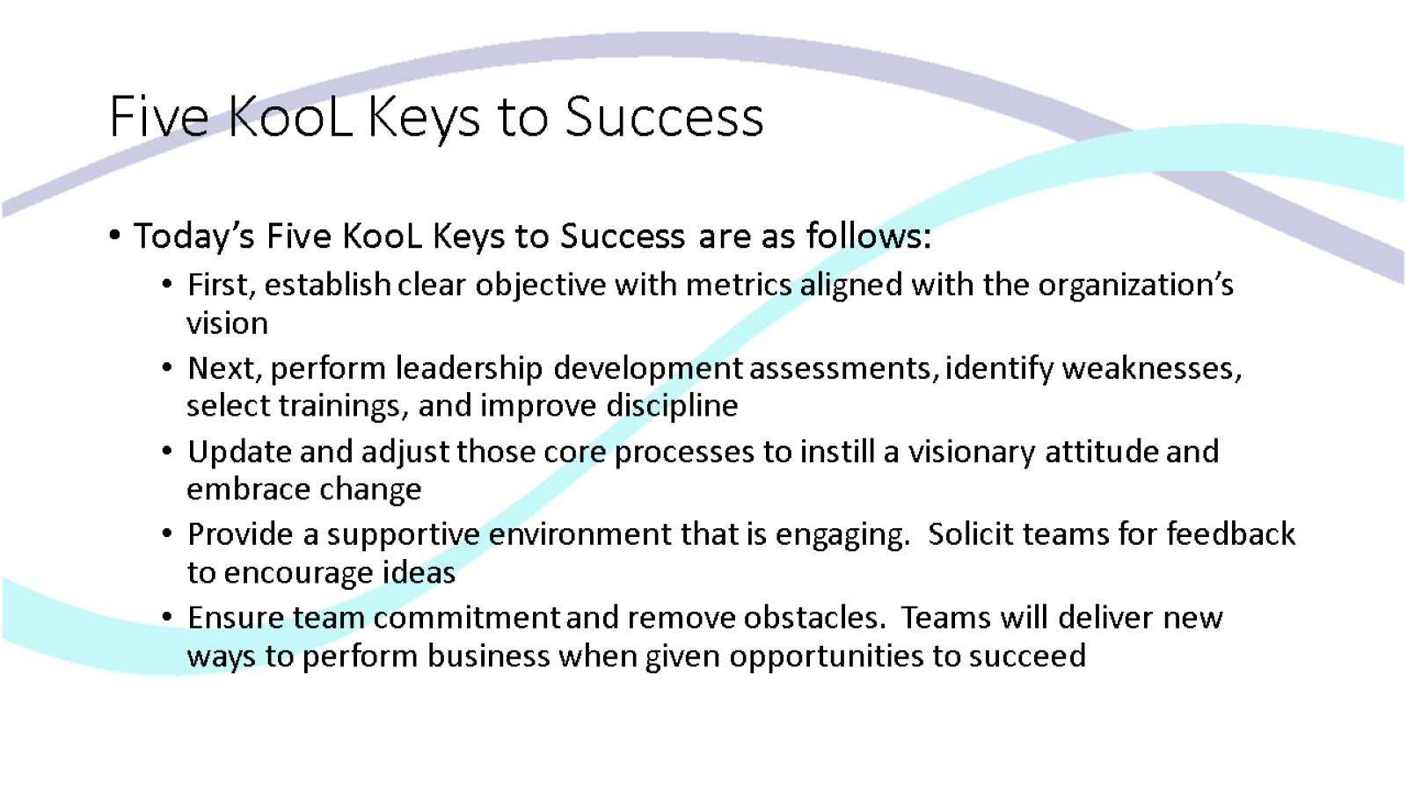
Five KooL Keys to Success

Slide 13
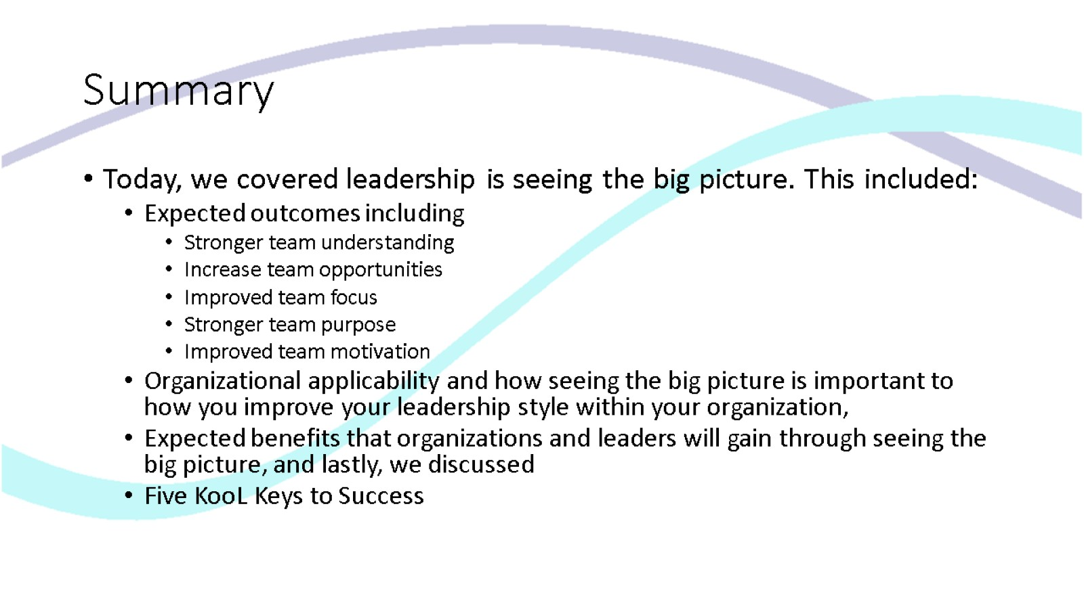
Summary

Slide 14
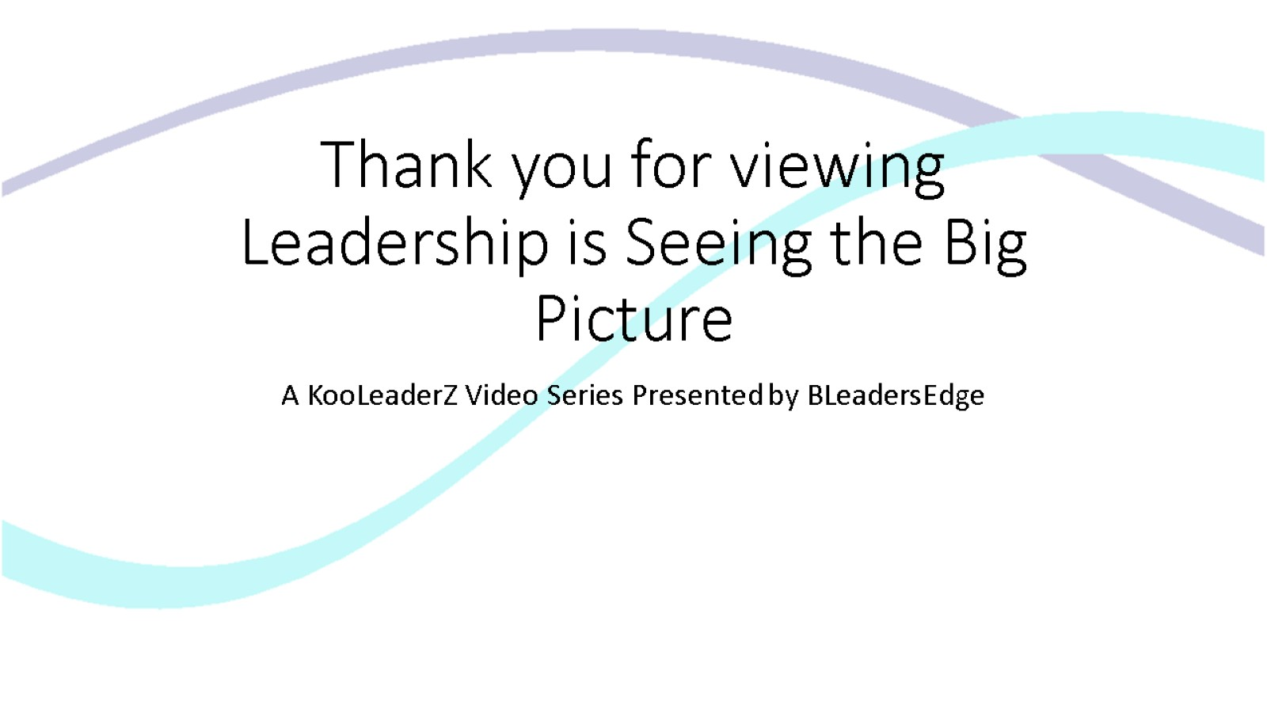
Thank you for viewing Leadership is Seeing the Big Picture

