Slide 1
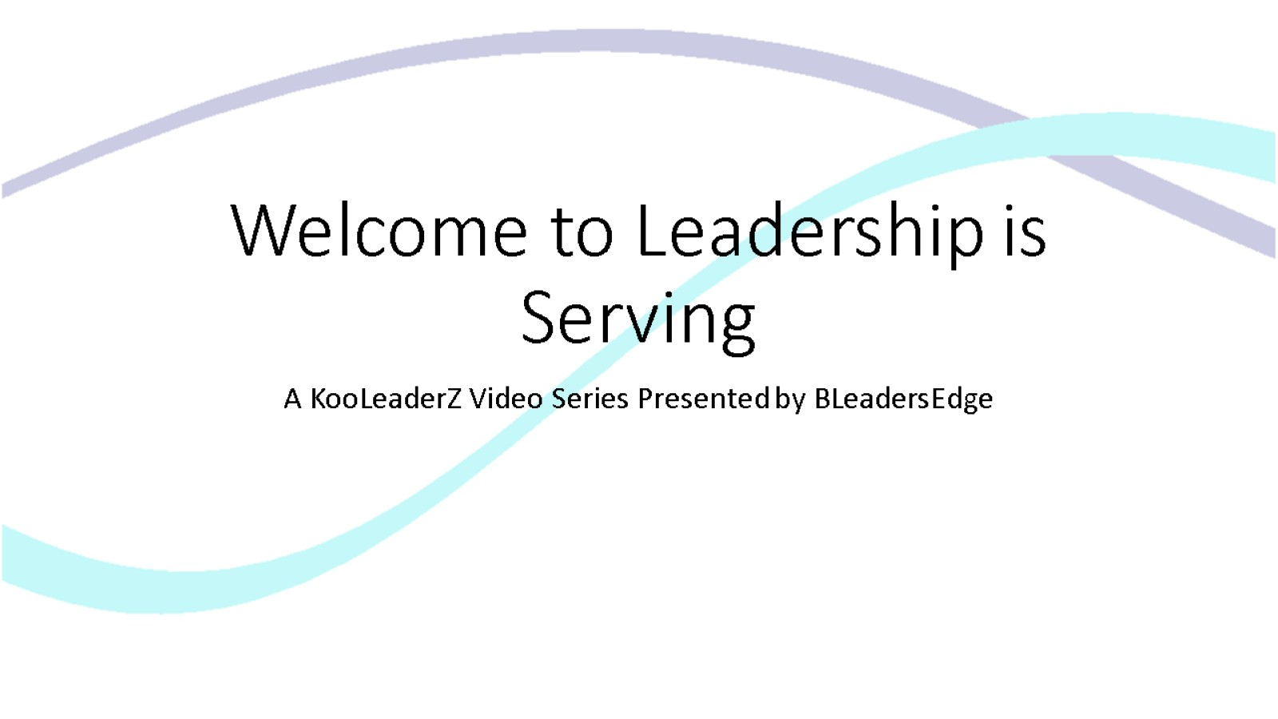

Welcome to Leadership is Serving

Slide 2
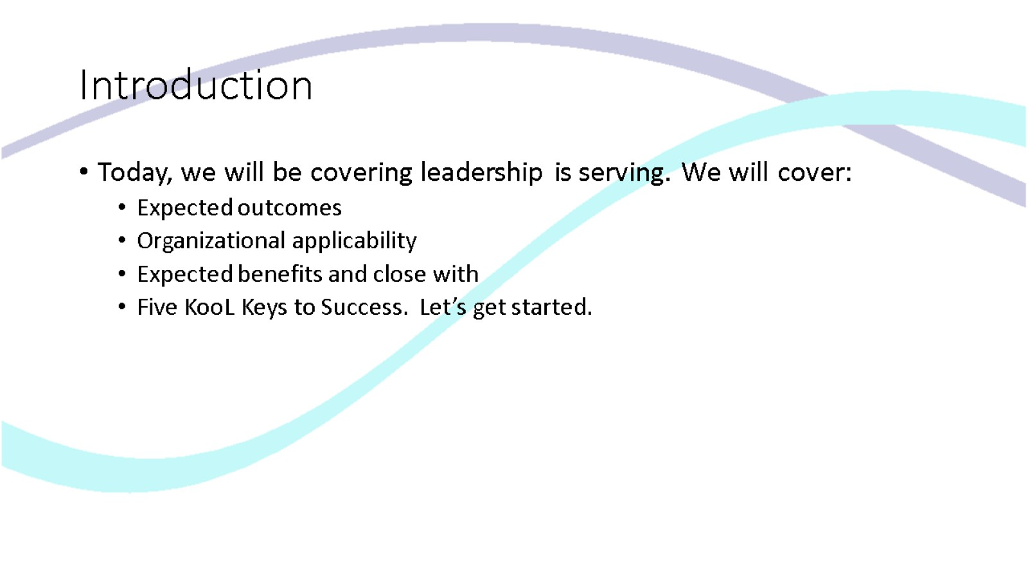
Introduction

Slide 3
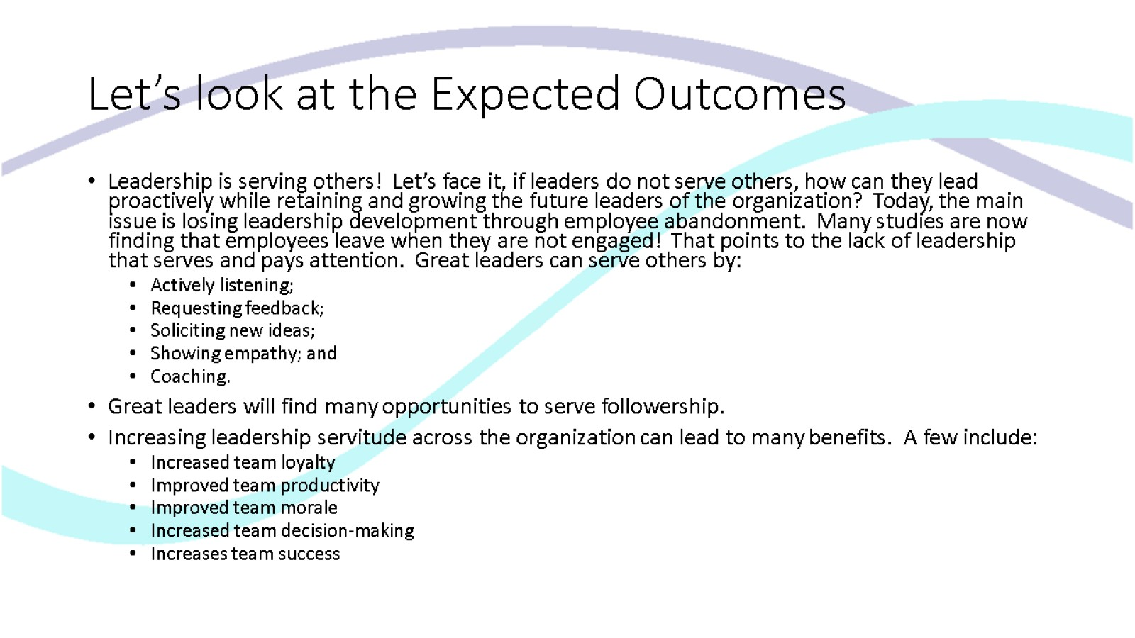
Let’s look at the Expected Outcomes

Slide 4
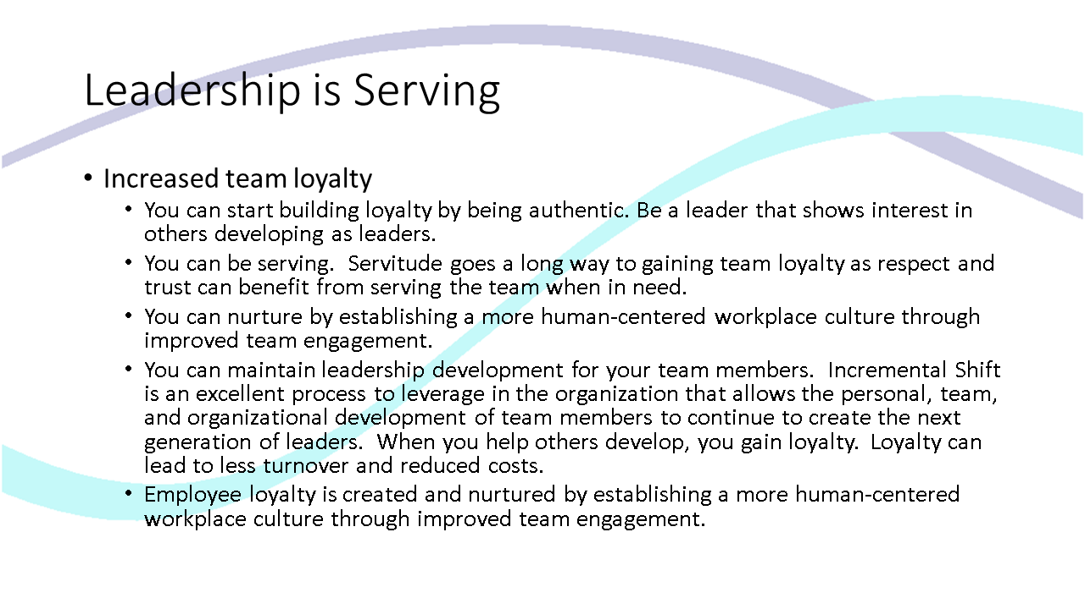
Leadership is Serving

Slide 5
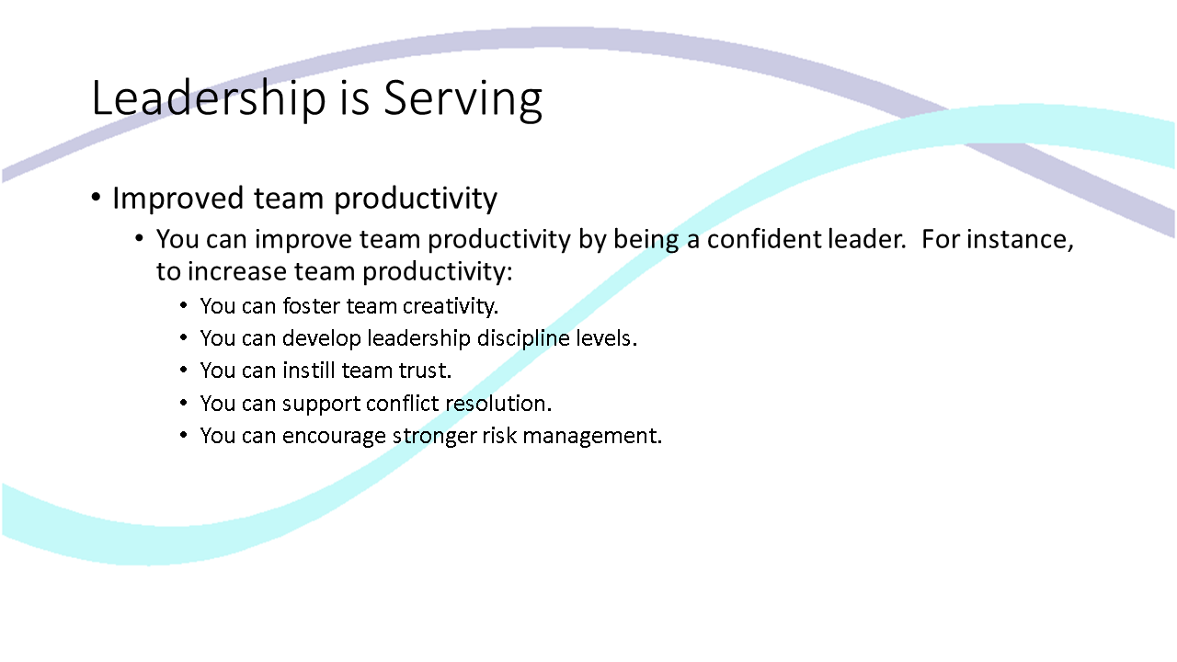
Leadership is Serving

Slide 6
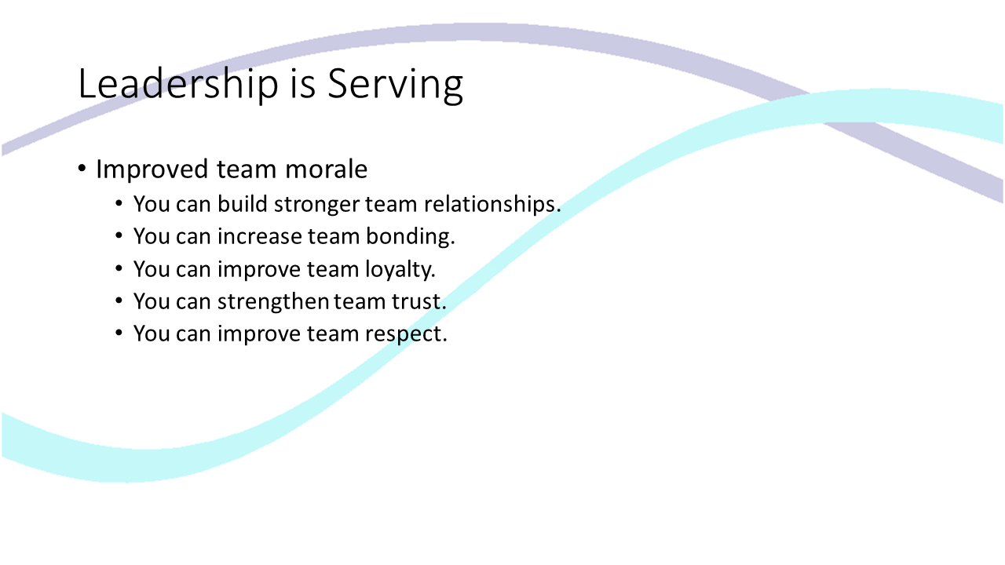
Leadership is Serving

Slide 7
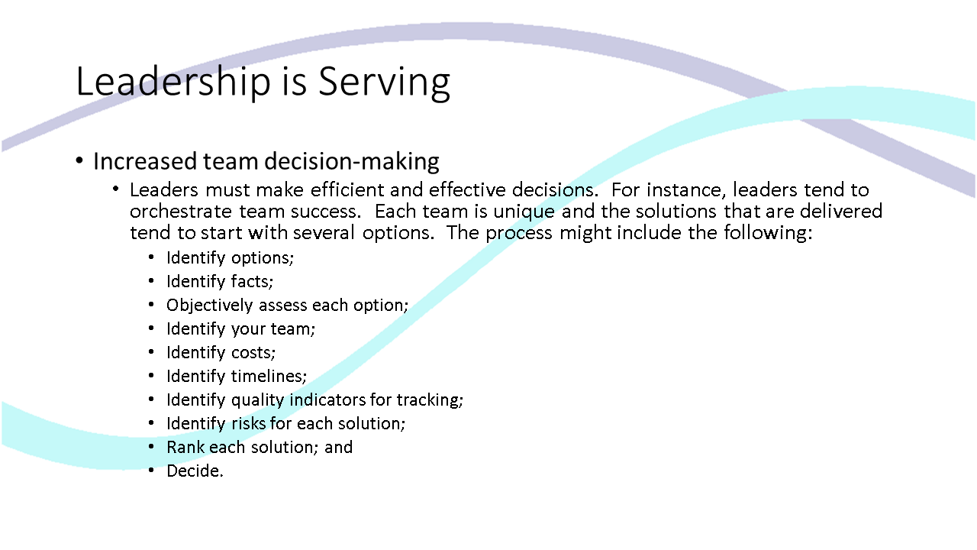
Leadership is Serving

Slide 8
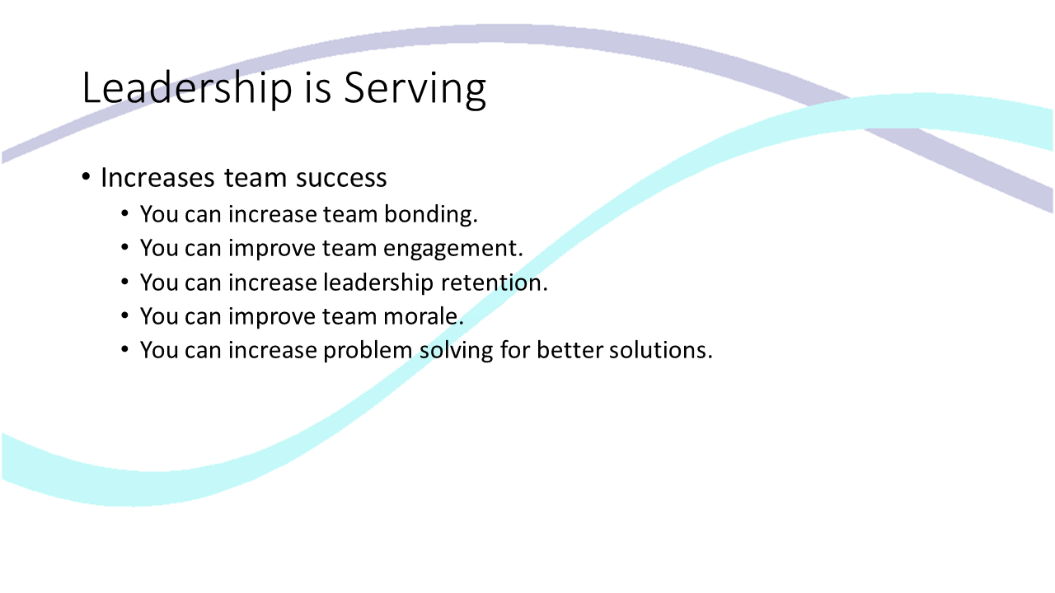
Leadership is Serving

Slide 9
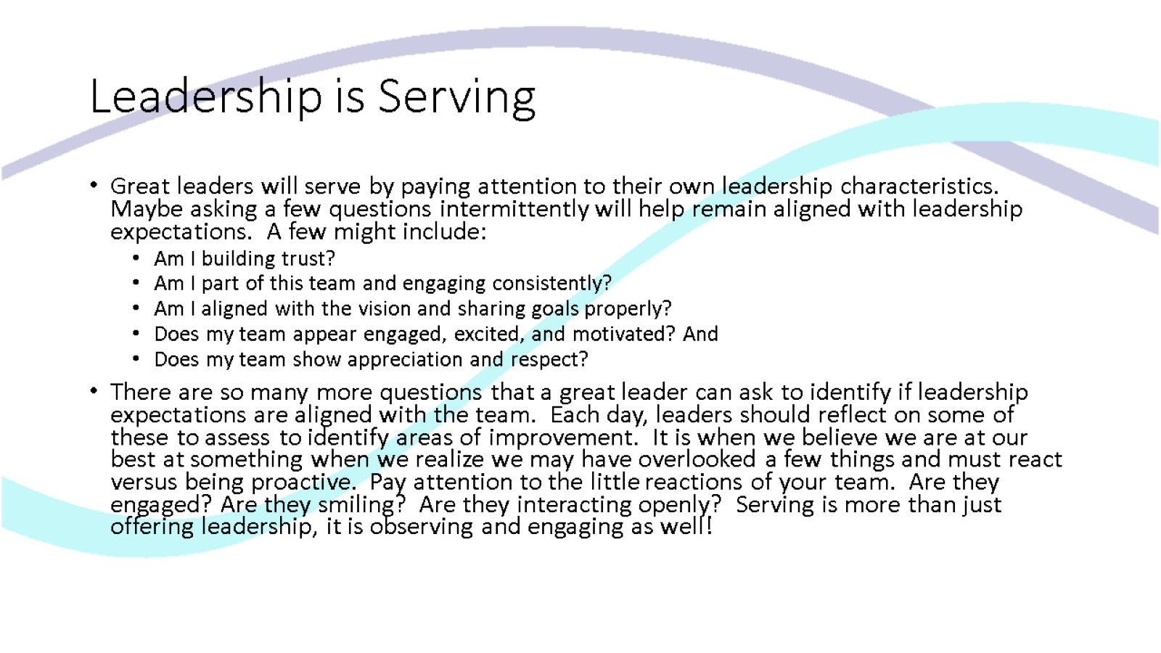
Leadership is Serving

Slide 10
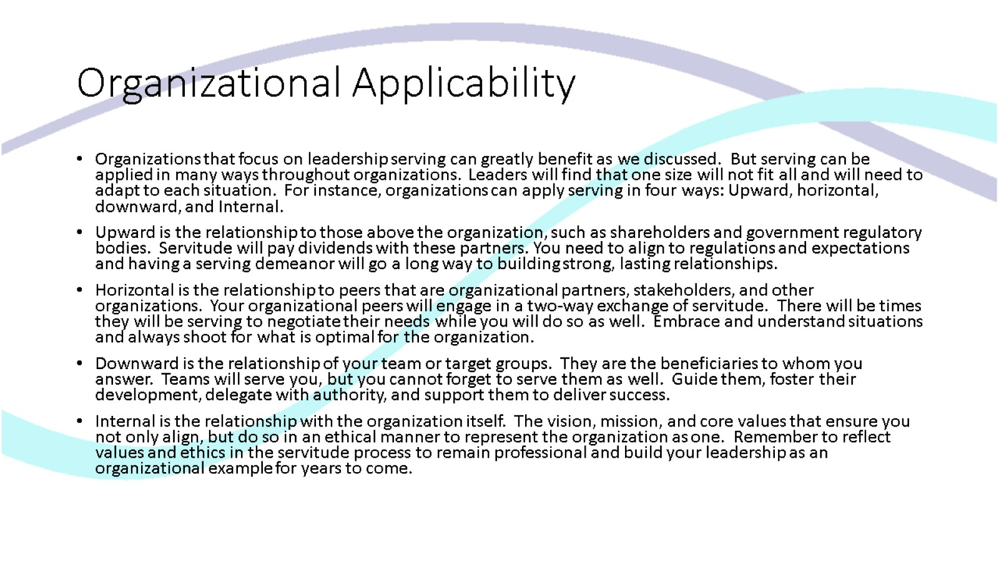
Organizational Applicability

Slide 11
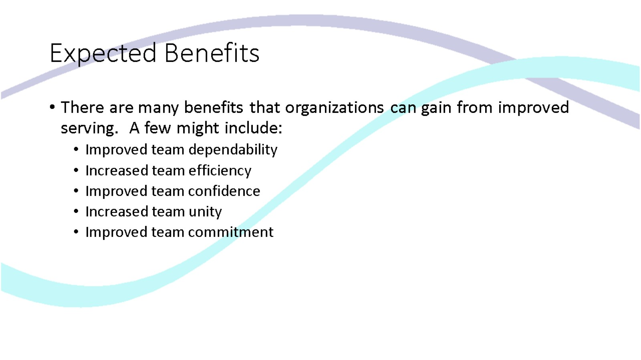
Expected Benefits

Slide 12
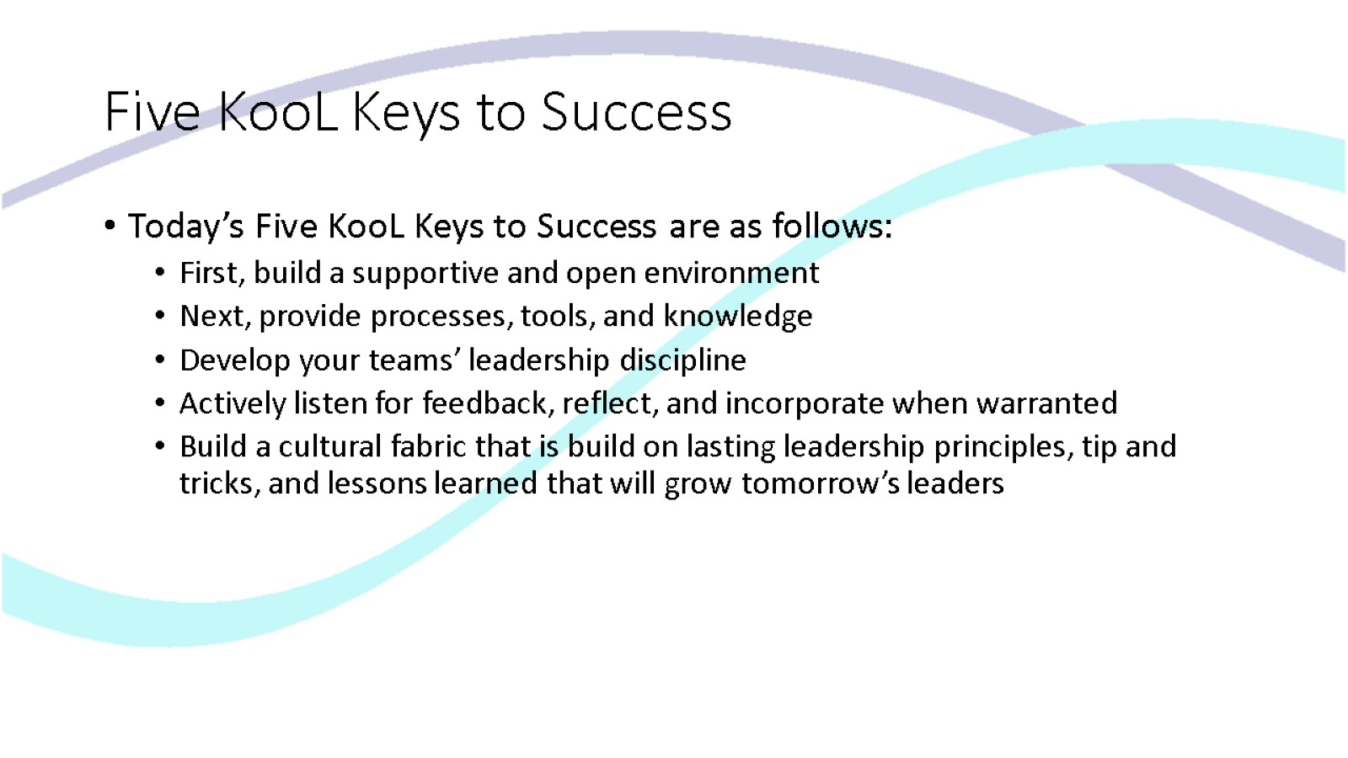
Five KooL Keys to Success

Slide 13
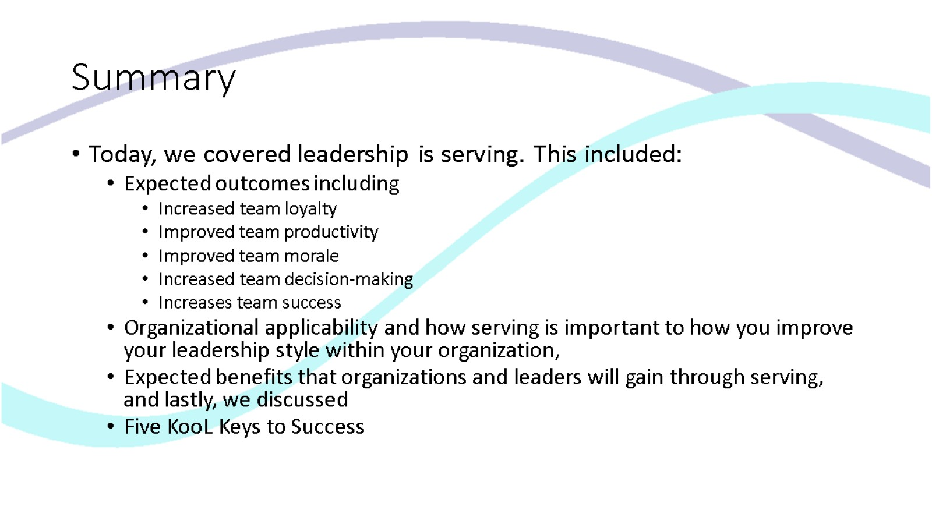
Summary

Slide 14

Thank you for viewing Leadership is Serving

