Slide 1


Welcome to Leadership is Spiritual Strength

Slide 2
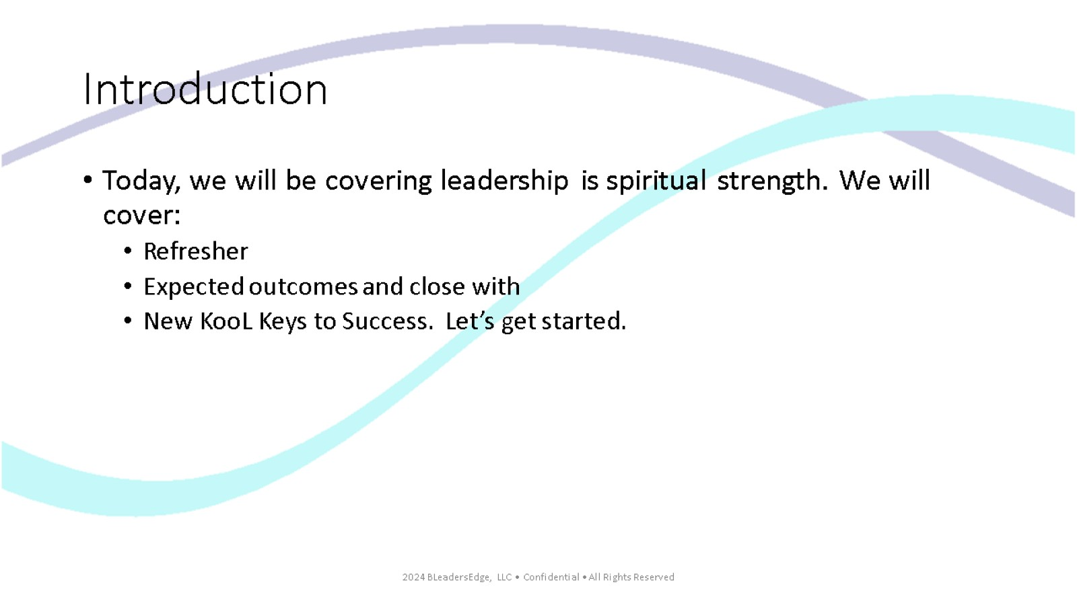
Introduction

Slide 3
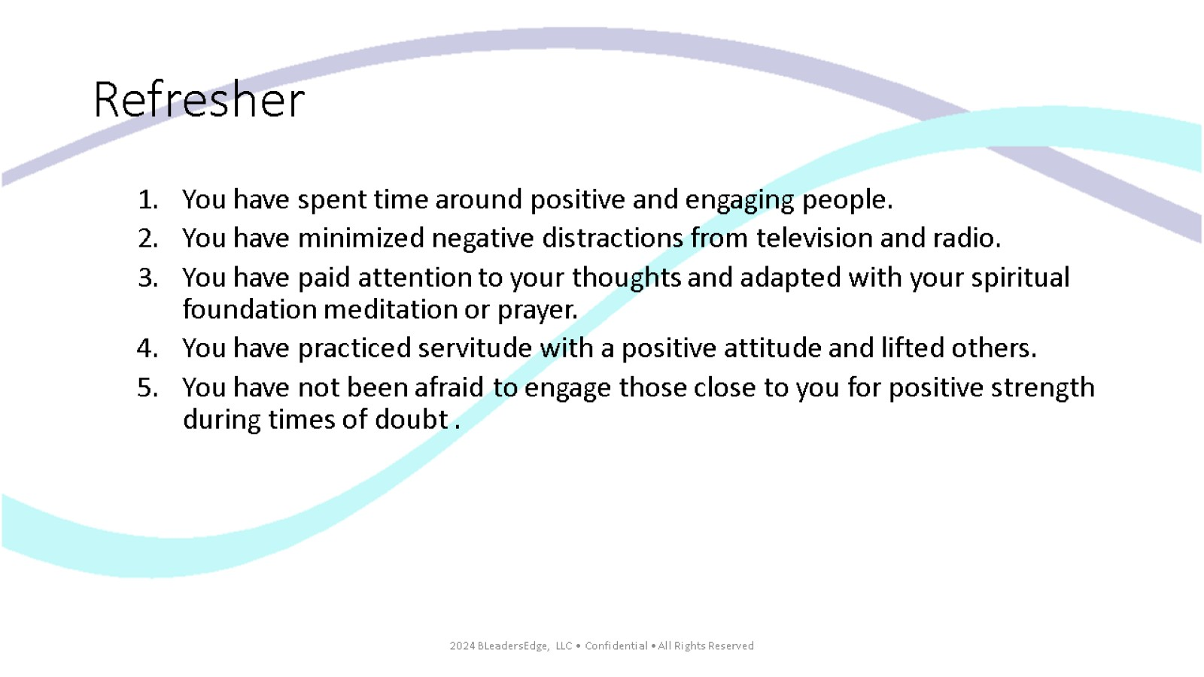
Refresher

Slide 4
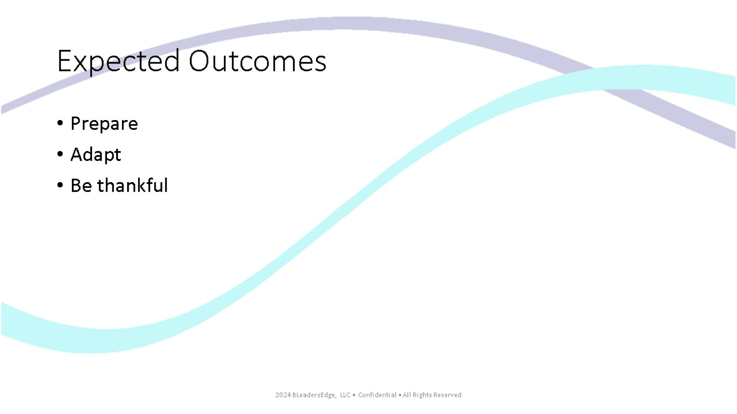
Expected Outcomes

Slide 5
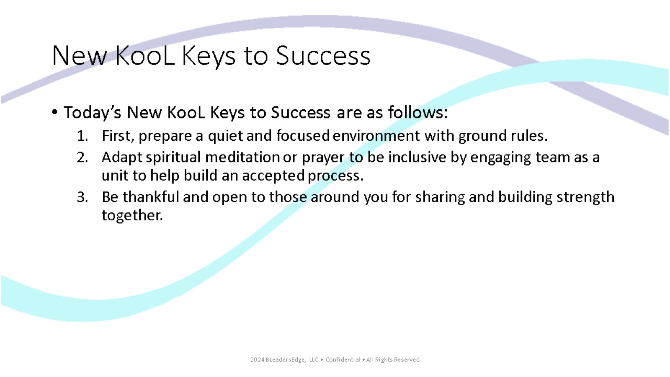
New KooL Keys to Success

Slide 6
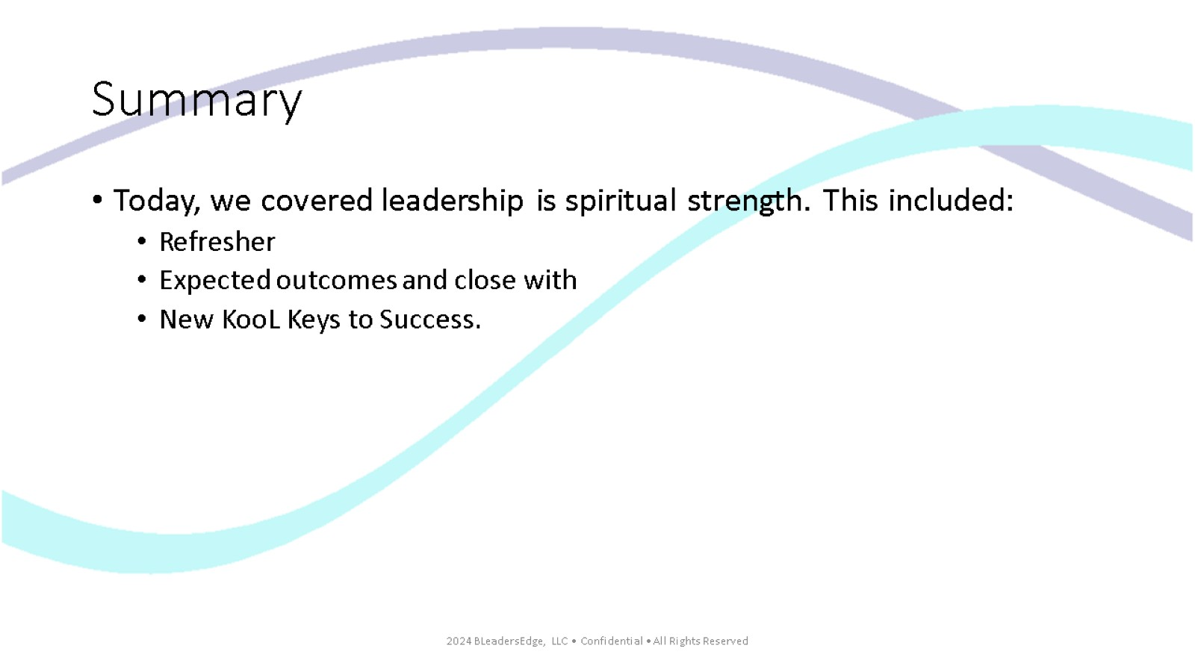
Summary

Slide 7

Thank you for viewing Leadership is Spiritual Strength

