Slide 1
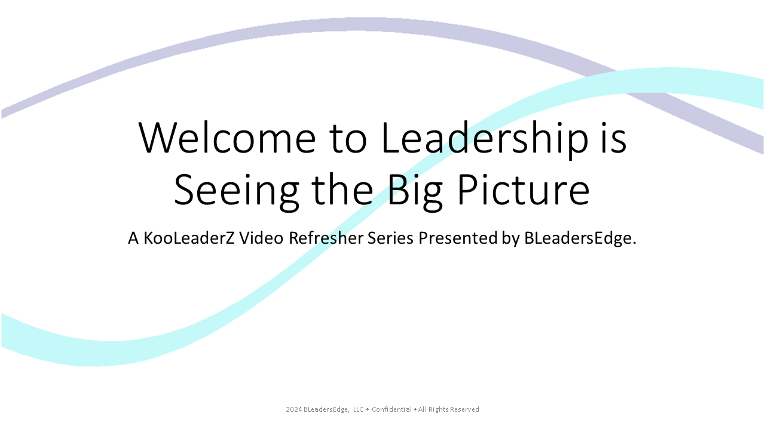

Welcome to Leadership is Seeing the Big Picture

Slide 2
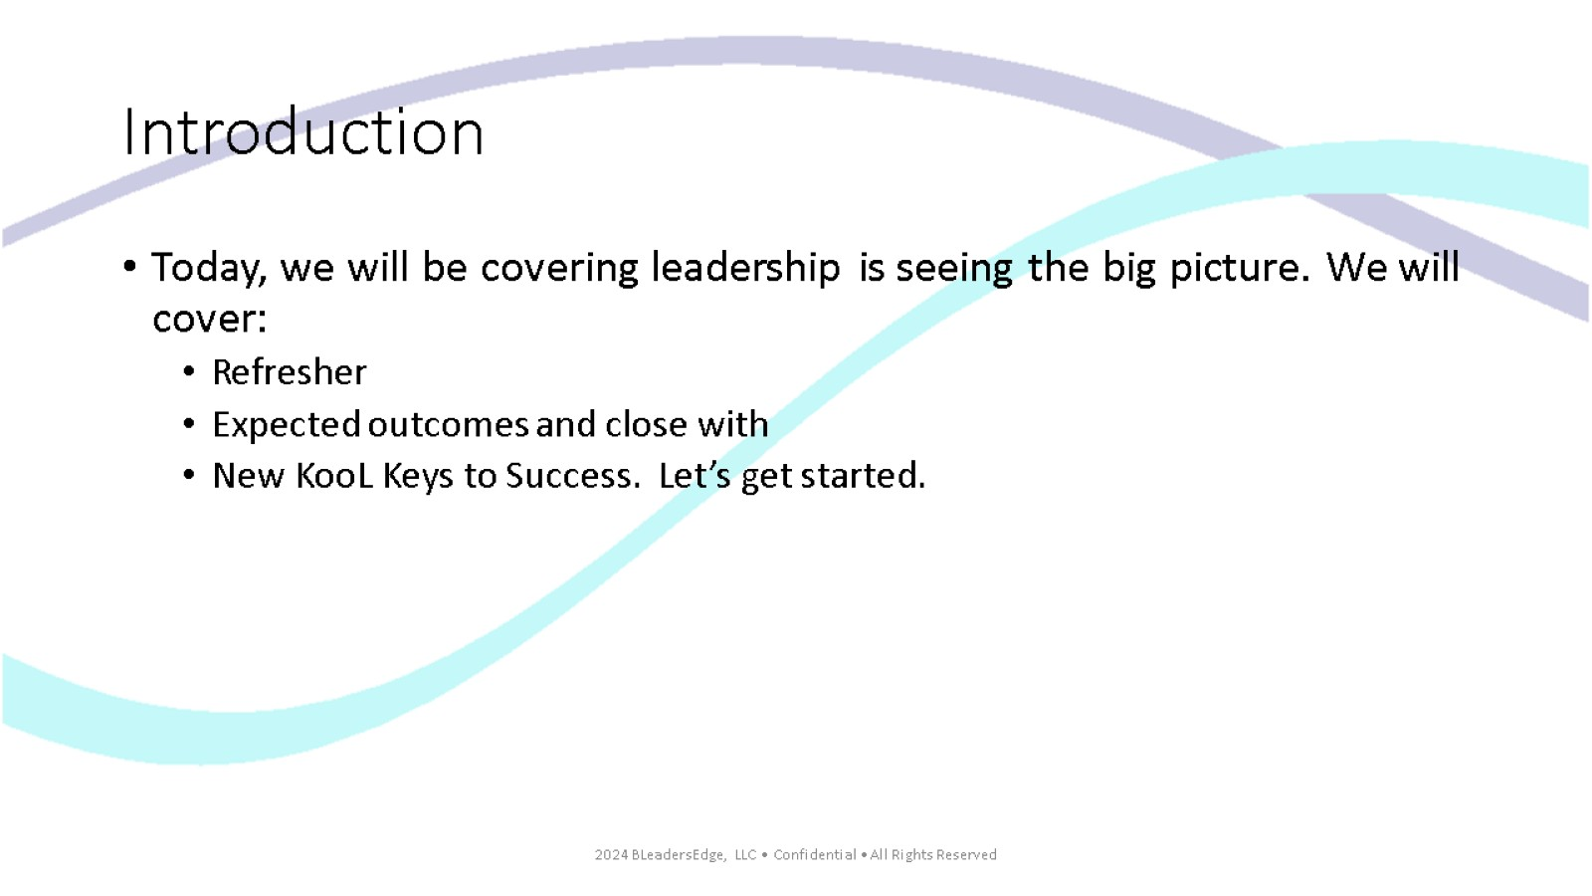
Introduction

Slide 3
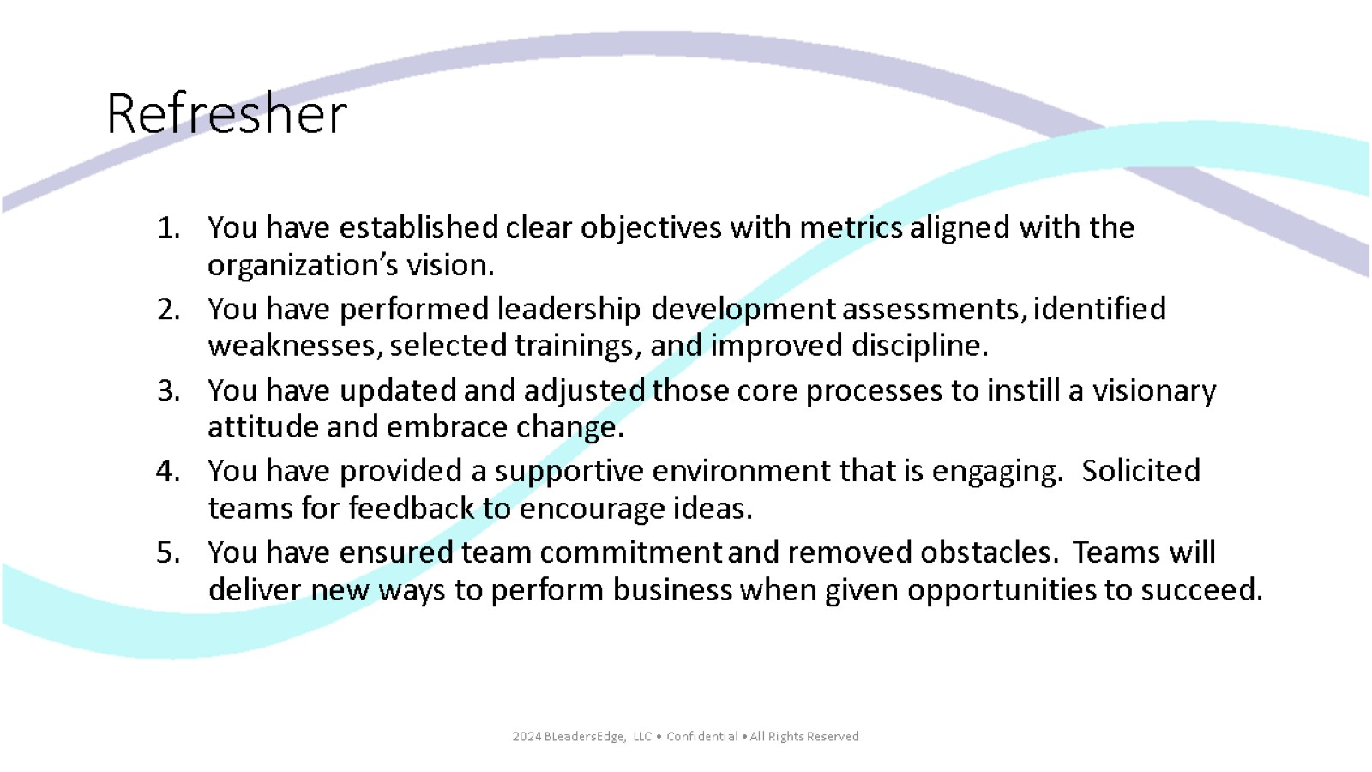
Refresher

Slide 4
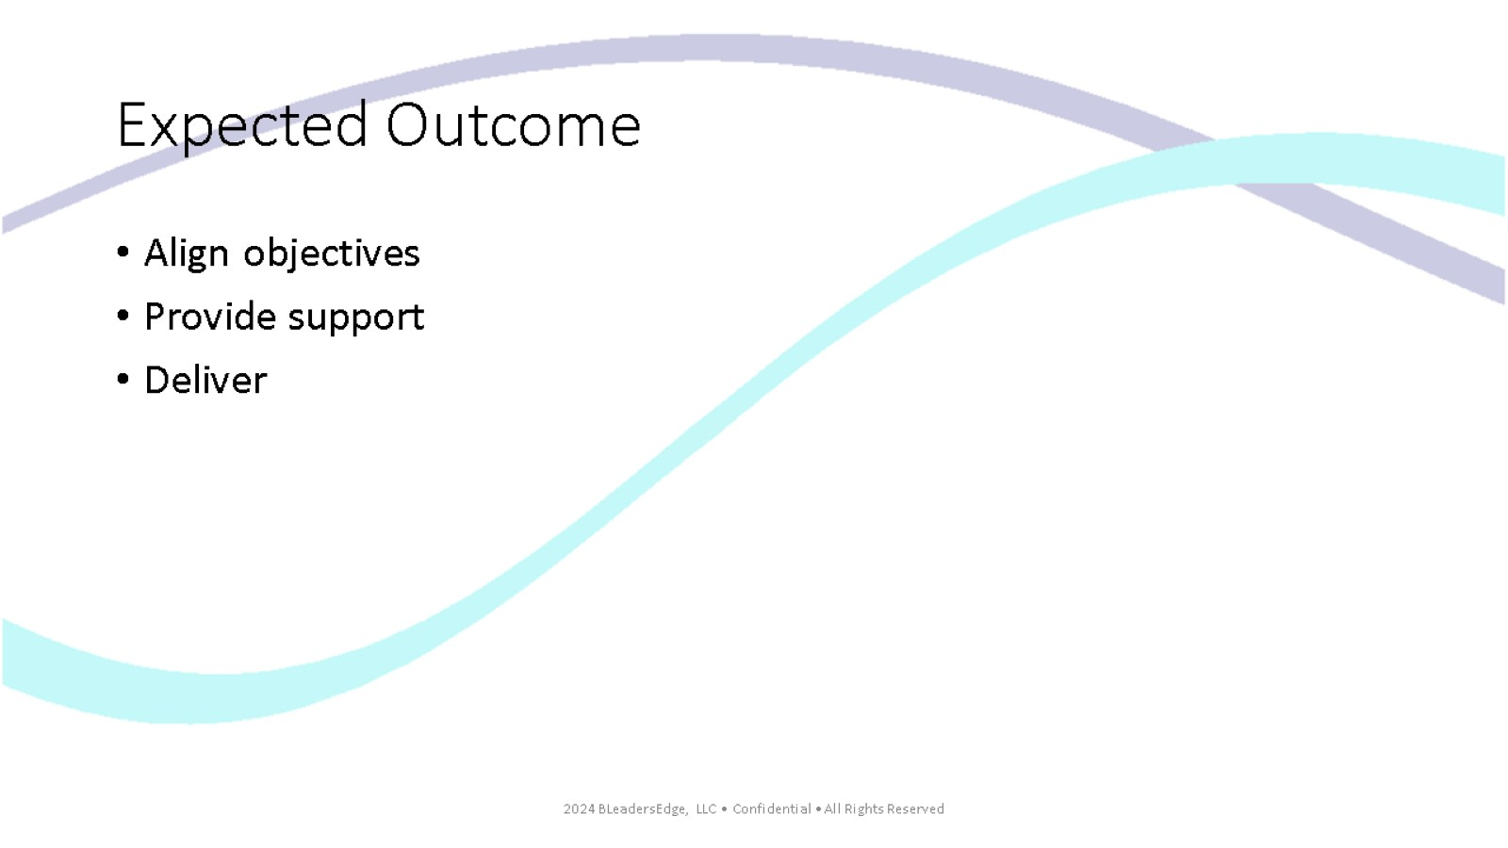
Expected Outcome

Slide 5
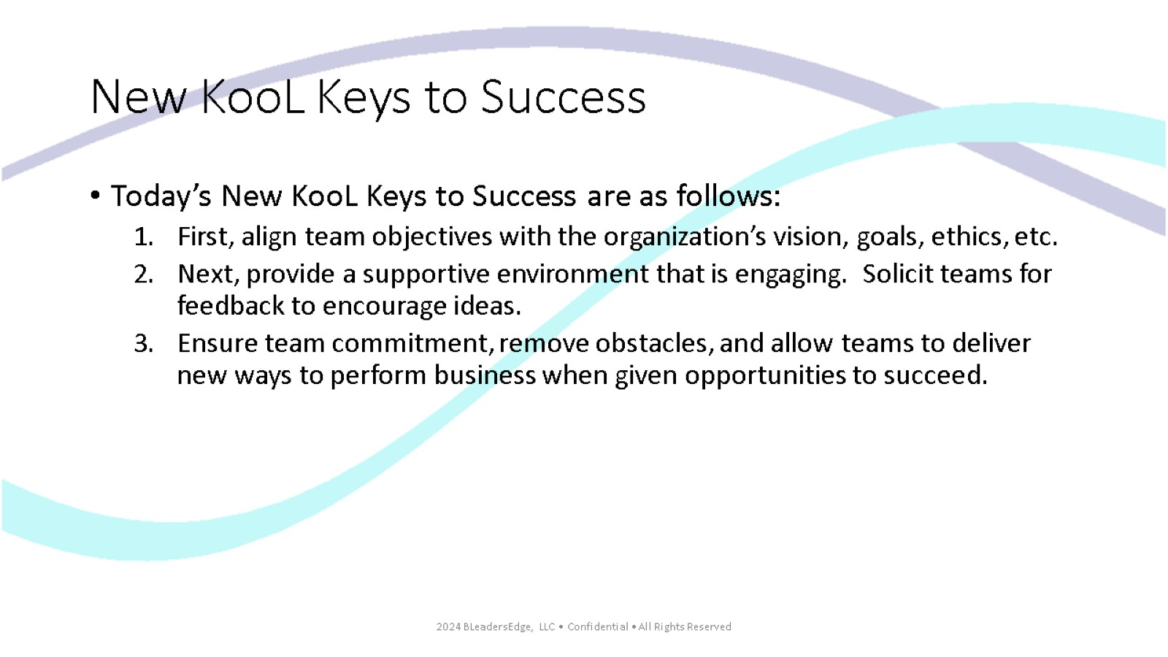
New KooL Keys to Success

Slide 6
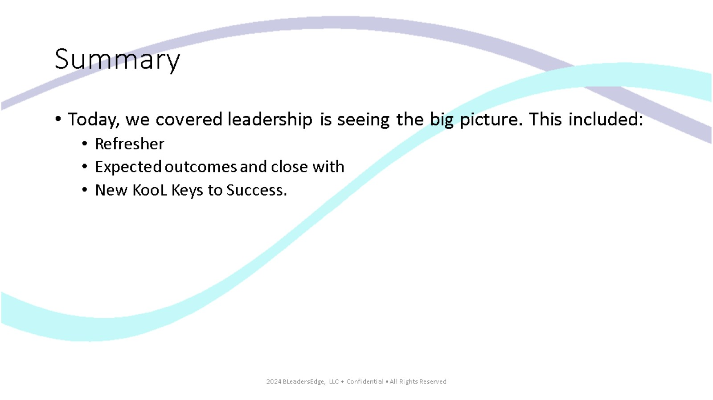
Summary

Slide 7
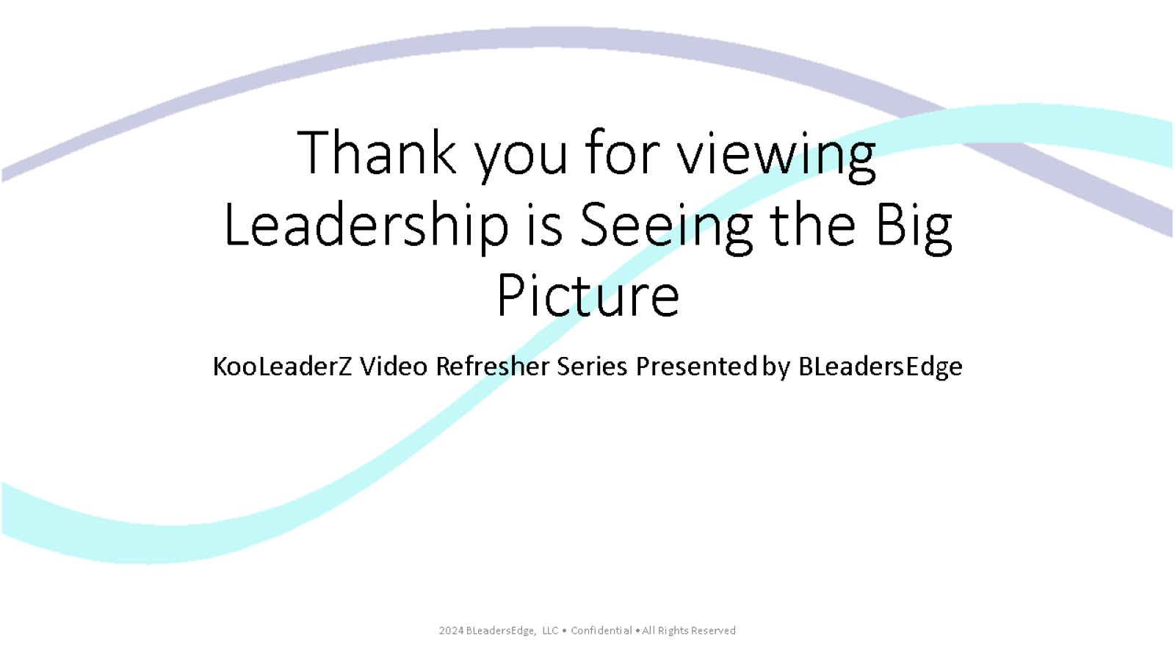
Thank you for viewing Leadership is Seeing the Big Picture

